Slide 1
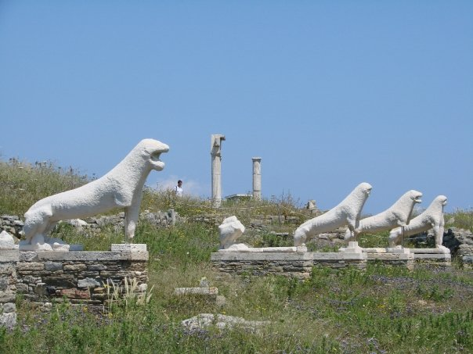
Documenting the loss!
Documenting the loss!
Alexandra Angeletaki
NTNU
Notes:
As a classical archaeologist coming from the Aegean Sea and working in most of the Cycladic islands as a field archaeologist, in my contact with people, protection and information was one of my main concerns. It has been, I don’t know how many times, that being at a place and becoming “ friends” with the locals gave me access to information about illegal digs and random finds. In Greece there is still fear for the state archaeologist and little knowledge about the importance of antiquities being found “in situ” by the common people.
When I moved to Norway and started working at the department of archaeology in Trondheim I was faced with a neglect of the rest of the world and a conscious focus of archaeology studies in the immediate region. I was asked to teach an introduction to CLassical archaeology first and then European archaeology and that lasted for 6 years where economic difficulties made the department to decide that any extra curriculum knowledge as they called was not a priority for them any more.
“They would concentrate on the things they knew that were at the immediate region”. I thought that is strange for a scholarly attitude!

Slide 2
Apamea 2006
Notes:
I like travelling and I travel in order to visit archaeological sites and Museums. In 2006 a group of archaeologists and friends organized a tour to the archaeological sites of Syria. Coming back from there I wrote an article about Syria as a living mosaic of history and culture. I was really amazed by the treasures of history and the coexistence of religions and cultures ..how little did I know?
article in Norwegian on Syria
https://www.researchgate.net/profile/Alexandra_Angeletaki/publications
visited 17.11.2015

Slide 3
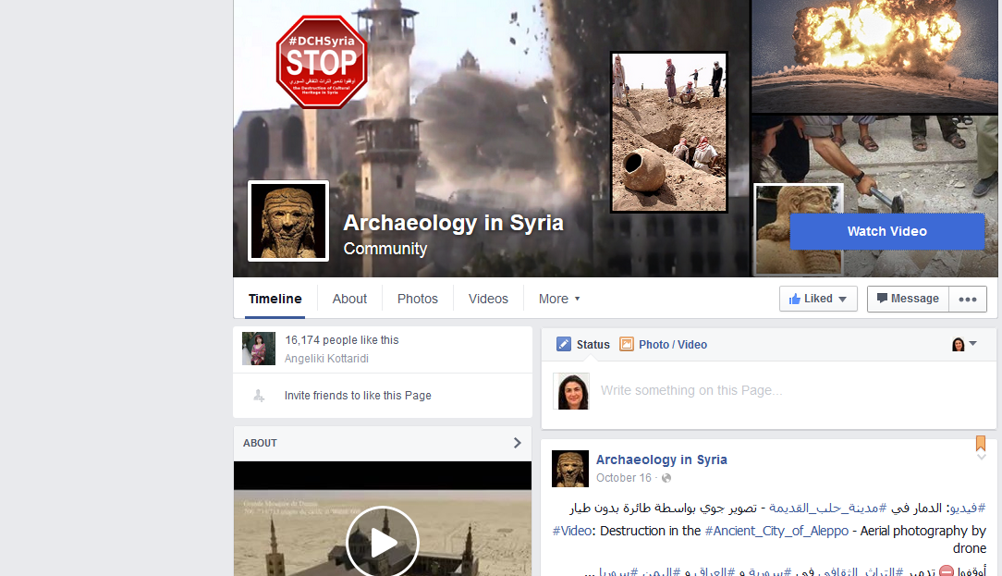
Notes:
When the war bursted out in Syria, I got information from the friends I had made there, and when a Facebook site was established and a few videos were
published about destructions in Aleppo I tried to contact some of the archaeologists there to see whether there was something we could help with.
The answer from them was “Create engagement, spread the news to the newspapers and people”. I have held lectures and contacted the big newspapers in
Norway to write an article about this. They responded immediately.

Slide 4
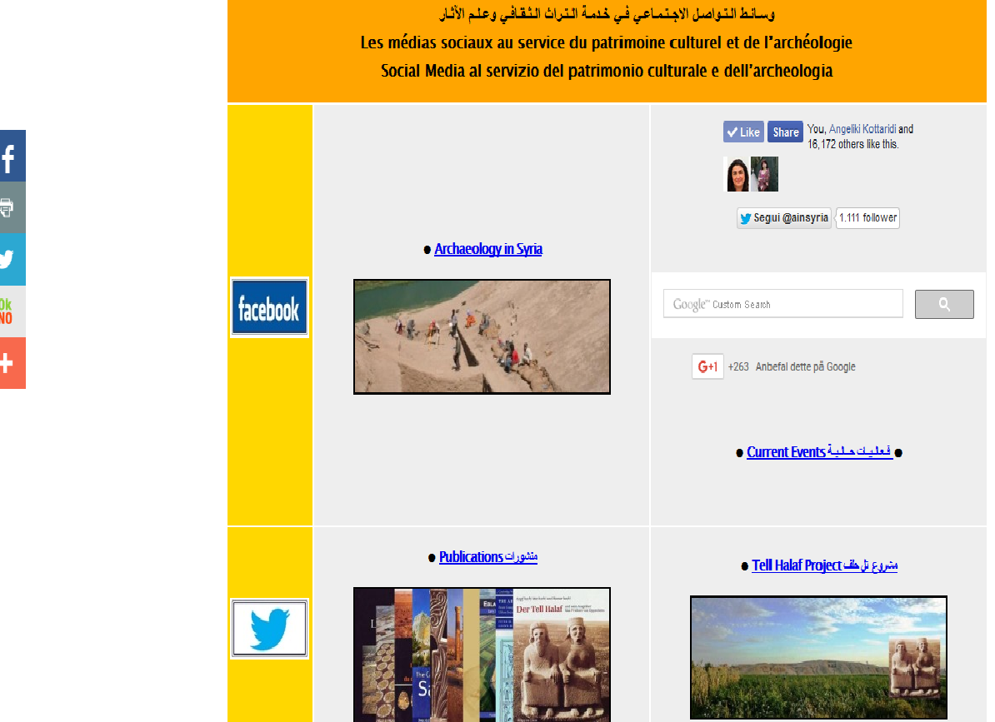
Umayad mosque
2006

Slide 5
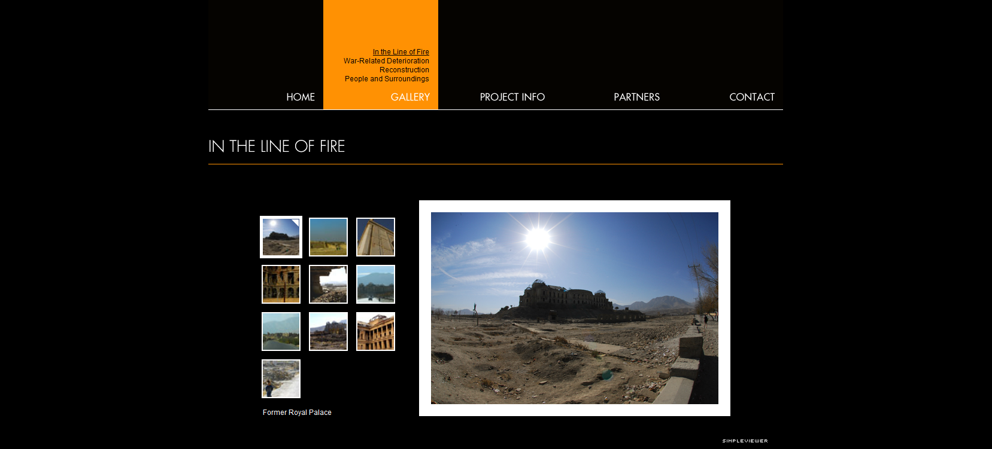
Notes:
Since then I developed a growing interest in the subject and I am still amazed that there is very little reference to that in the department of archaeology studies in Trondheim. I have occasionally brought it up and after, Axel Christophersen, who is a professor created a project in Afghanistan some focus has been on that, but students and academics in our department still seem to ignore this discussion as an important one. His exhibitions and lectures added a value to the debate around the destruction of antiquities in Iraq, Afghanistan and in 2012 in Syria. Holding a professorship in Trondheim has now given him the possibility to inform and engage students in the issue.
It was already in 2005 Axel began to plan the project “Endangered Cultural heritage” in Afghanistan along with a social anthropologist, Kim Sørenssen. The idea was to document the damage to cultural heritage and then use these images in photo exhibitions which could be displayed both locally and internationally to create awareness about what happened to cultural monuments in war. Photo exhibitions were intended to help create awareness and disseminate information on cultural heritage that is threatened.
They also created a homepage http://www.afghachrome.com

Slide 6
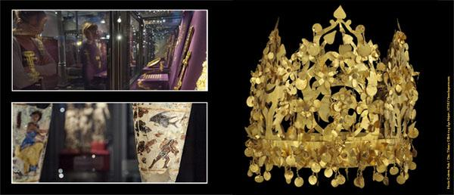
The purpose of that project was to elucidate the relationship between war and world heritage, and the relationship between cultural heritage and human rights. It is essential that these relationships be clearly defined and visualized in a conflict in which Norway is involved both military and humanitarian.
Axel and Kim
Notes:
As Axel wrote: The purpose of that project was to elucidate the relationship between war and world heritage, and the relationship between cultural heritage and human rights. It is essential that these relationships be clearly defined and visualized in a conflict in which Norway is involved both military and humanitarian. Since then Norway has been involved in the Syria war too.
Axel said to me “There are not many in academia who are aware of this work, for Kim and I have not published anything about this in scientific journals. We have concentrated on writing popular and to primarily use the visual medium. That is not applicable within academia”.

Slide 7
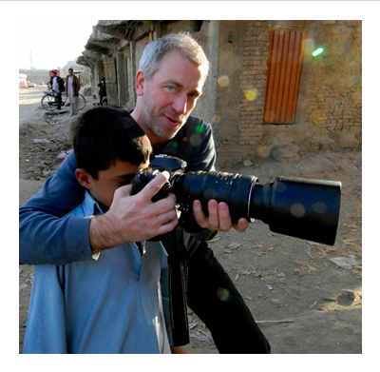
Visualisation
Dead cities in Syria 2006
Visualisation helps
Vi

Slide 8
Th
The question is, why such a few archaeologists get involved in the debate of endangered heritage?
Damascus 2006
Notes:
The question is: Why is it not? For me it was important to reflect upon our practices when it comes into our involvement in these wars. Either that is people`s lives or their heritage… for me the question and the ethical dilemma is still the same? We are involved in these wars either by selling drones as Norway does, or by participating in the decisions Nato takes. It feels the same, that means I care the same, and I oppose to these interventions both for losing human lives and for the protection of their heritage and their right to have a historical memory.
For me the question is not if we as archaeologists should participate in a debate around such subjects, the question for me is why don’t we?
There should be more people involved in that, more academics.

Slide 9
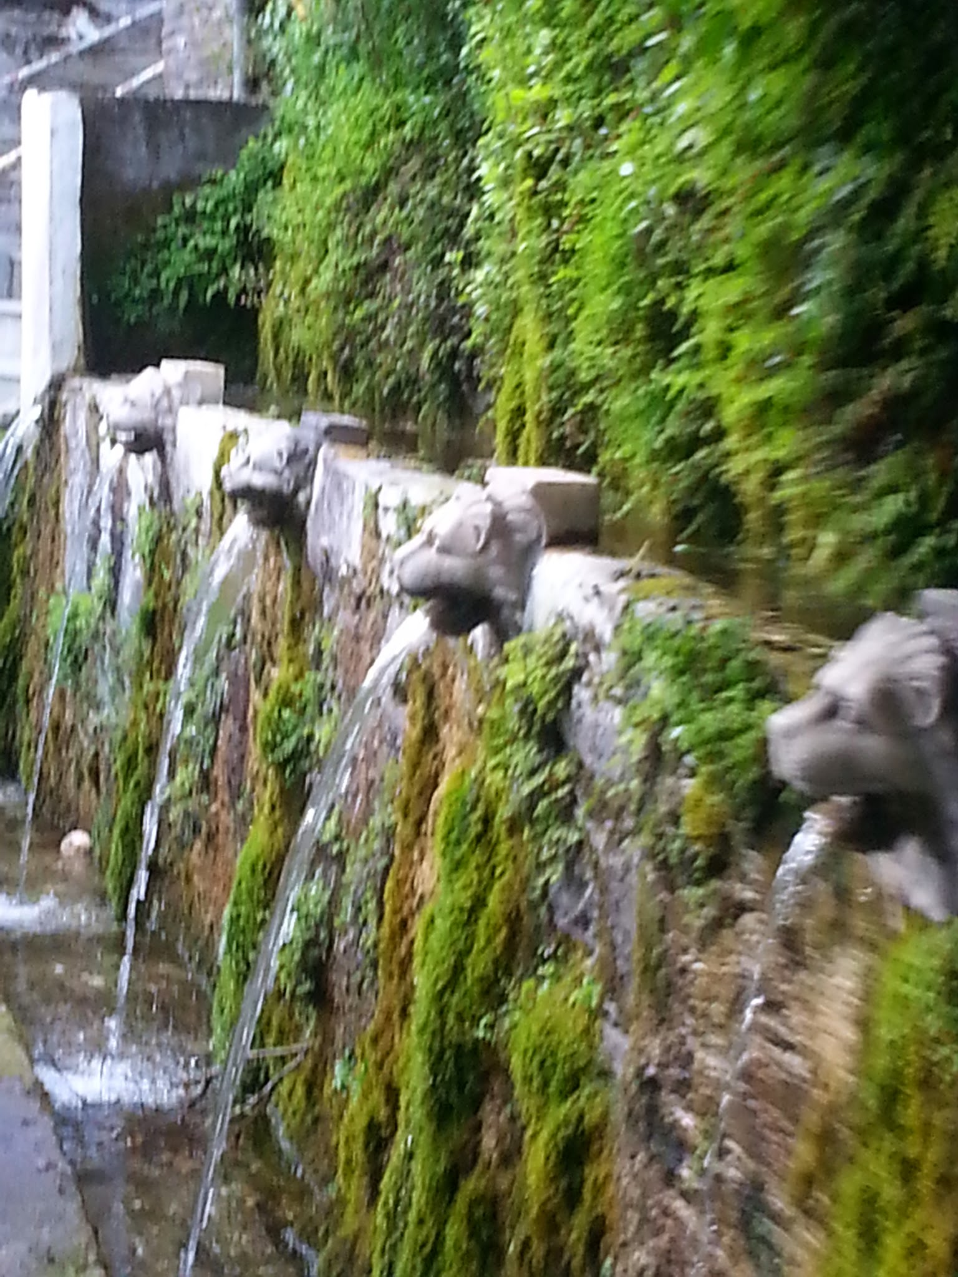
What does war bring?
Loss of civilian lives
Poverty-diseases-famine
Destruction of infrastructure
Humanitarian catastrophy
Destruction of Heritage
Extended Looting
Illicit market, raise of prices
Loss of memory
Loss of identity
Historical discontinuity
Loss of self!

Slide 10
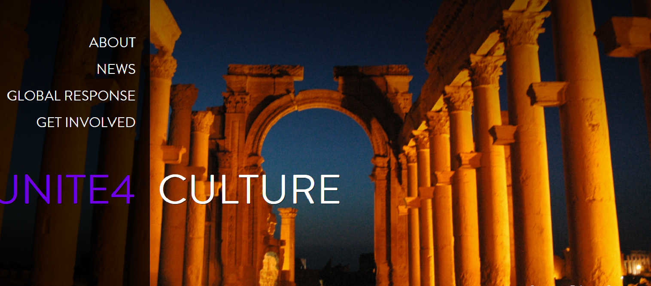
Actions and reactions
Unsesco: calls on everyone to stand up against extremism and radicalization by celebrating the places, objects and cultural traditions that make the world such a rich and vibrant place.
To foster intercultural and interfaith dialog.
To protect and safeguard heritage under threat.
To inform and keep informed.
To document the loss
to prepare post-conflict priority actions
Notes:
So I started looking around to see which way I could participate to initiatives that do something and let people know about the situation. Unesco has been working already with many such issues and financed projects in order to both engange the public and protect endagered heritage. Unesco has also been working on the legal status of selling antiquities with out provenance!
Unite4Heritage is a global movement powered by UNESCO that aims to celebrate and safeguard cultural heritage and diversity around the world. Launched in response to the recent attacks on heritage, the campaign calls on everyone to stand up against extremism and radicalization by celebrating the places, objects and cultural traditions that make the world such a rich and vibrant place.

Slide 11
Protect and safeguard Syrian cultural heritage through enhanced technical assistance and capacity-building for national stakeholders and beneficiaries, by:
providing technical support for the establishment of a police database of looted artefacts;
training police forces and customs officers in Syria and adjacent countries to fight illicit trafficking of cultural property (and on the specific tools available to facilitate and improve the implementation of the 1970 UNESCO Convention);
training national stakeholders to protect movable heritage and museums during and after the conflict;
providing technical assistance and training for the protection of built cultural heritage and planning
conservation and restoration works in view of the recovery phase;
training of national stakeholders concerning the core concepts and mechanisms of the 2003
Notes:
Another action the Unesco organised was “Protect and safeguard Syrian cultural heritage” through enhanced technical assistance and capacity-building for national stakeholders and beneficiaries, by organising concrete actions as you see here!

Slide 12
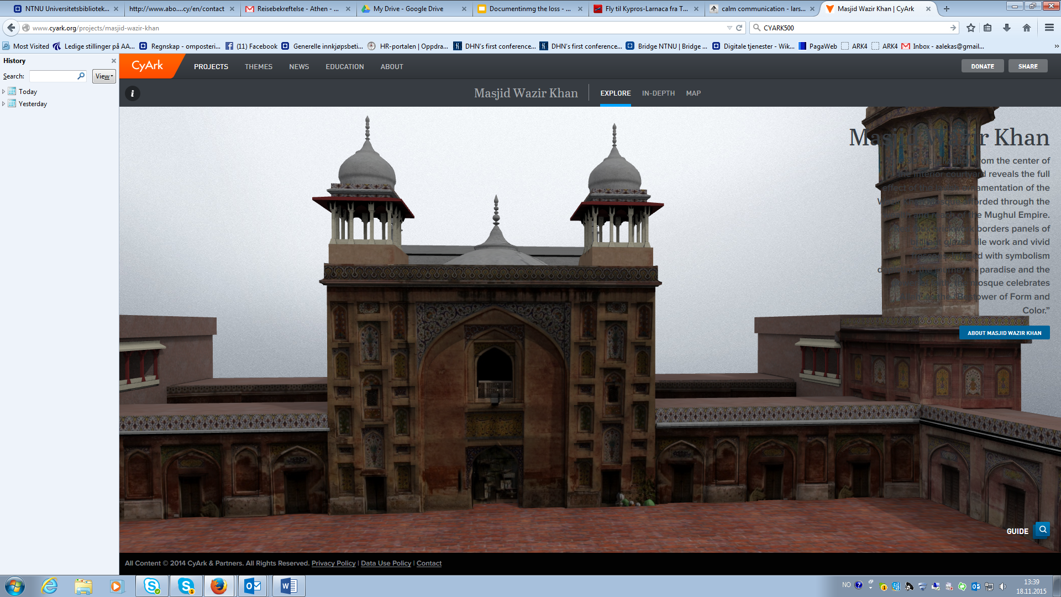
Notes:
This october I attended the summit of CYARK500 in Berlin. CyArk was founded in 2003 to ensure heritage sites are available to future generations, while making them uniquely accessible today. CyArk operates internationally as a 501(c)3 non-profit organization with the mission of using new technologies to create a free, 3D online library of the world's cultural heritage sites before they are lost to natural disasters, destroyed by human aggression or ravaged by the passage of time. All are invited to contribute you can donate, partner, or volunteer. CyArk also digitally preserves sites that are local or regional importance. While these sites may not be of universal appeal, they are often very important to the communities that support them.It currently has 50 sites completed, with another 50 in various stages of completion. CyArk is supported by public sector partners including Historic Scotland and the National Park Service, private sector partners including Autodesk, Leica Geosystems, Faro Technologies and Iron Mountain who provide in-kind and cash contributions. CyArk also receives funding from research organizations, foundations, service provider organizations and contributions from the public.

Slide 13
A student on CYARK500 inernship
“Perhaps the most rewarding project I worked on at CyArk was Anqa, which is an Arabic name for a mythological phoenix. Still in its early stages, the Anqa project is a large scale initiative designed to preserve sites across the Middle East and North Africa (MENA). My role at CyArk was to draft a list of “priority sites” in the region. During my research, I found that many of the sites that made their way to the top of my list due to their rich historical and cultural significance had been subject to arson.
“Why hasn’t more been done and why isn’t more being done?”
Amelia Desnoo

Slide 14
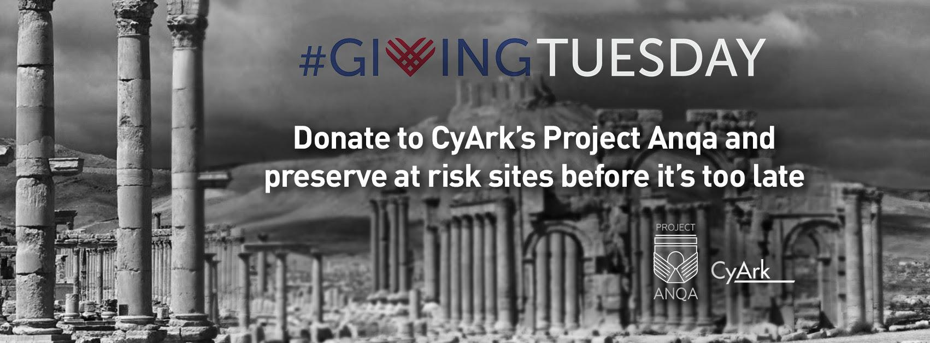

Slide 15
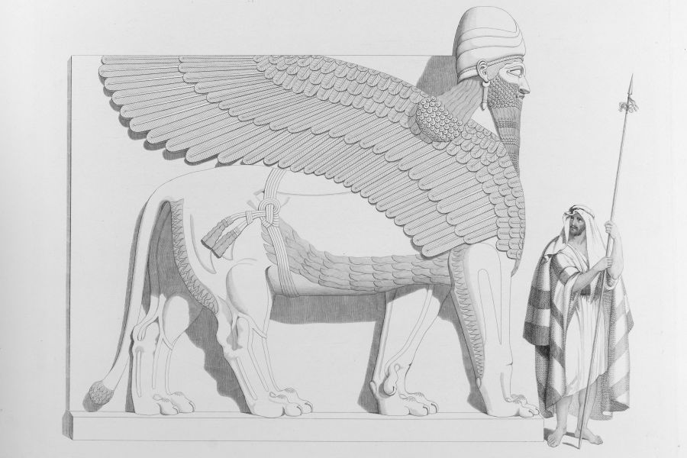
Notes:
The Gunnerus library where I work is the first scientific library of Norway. It was established in 1768 togther with the Museum of Natural Sciences and archaeology and the Royal Society in Trondheim! A collegue of mine Lise Bender Jørgensen that has been working in Egypt took the initiative to set up a exhibition in the library based on the books we had in the library about the places that have been destroyed. That created an opportunity for us to look into our collections and we actually found the book Hayard had published of his work in Ninive early 1840 with many colourful detais of the ruins he documened at that time by drawing! Another visualization rechnique. Students and scholars were drawn to us and the norwegian radio made a programm about it. I am in dialogue with CYARK500 to incorporate our data to their repository.

Slide 16
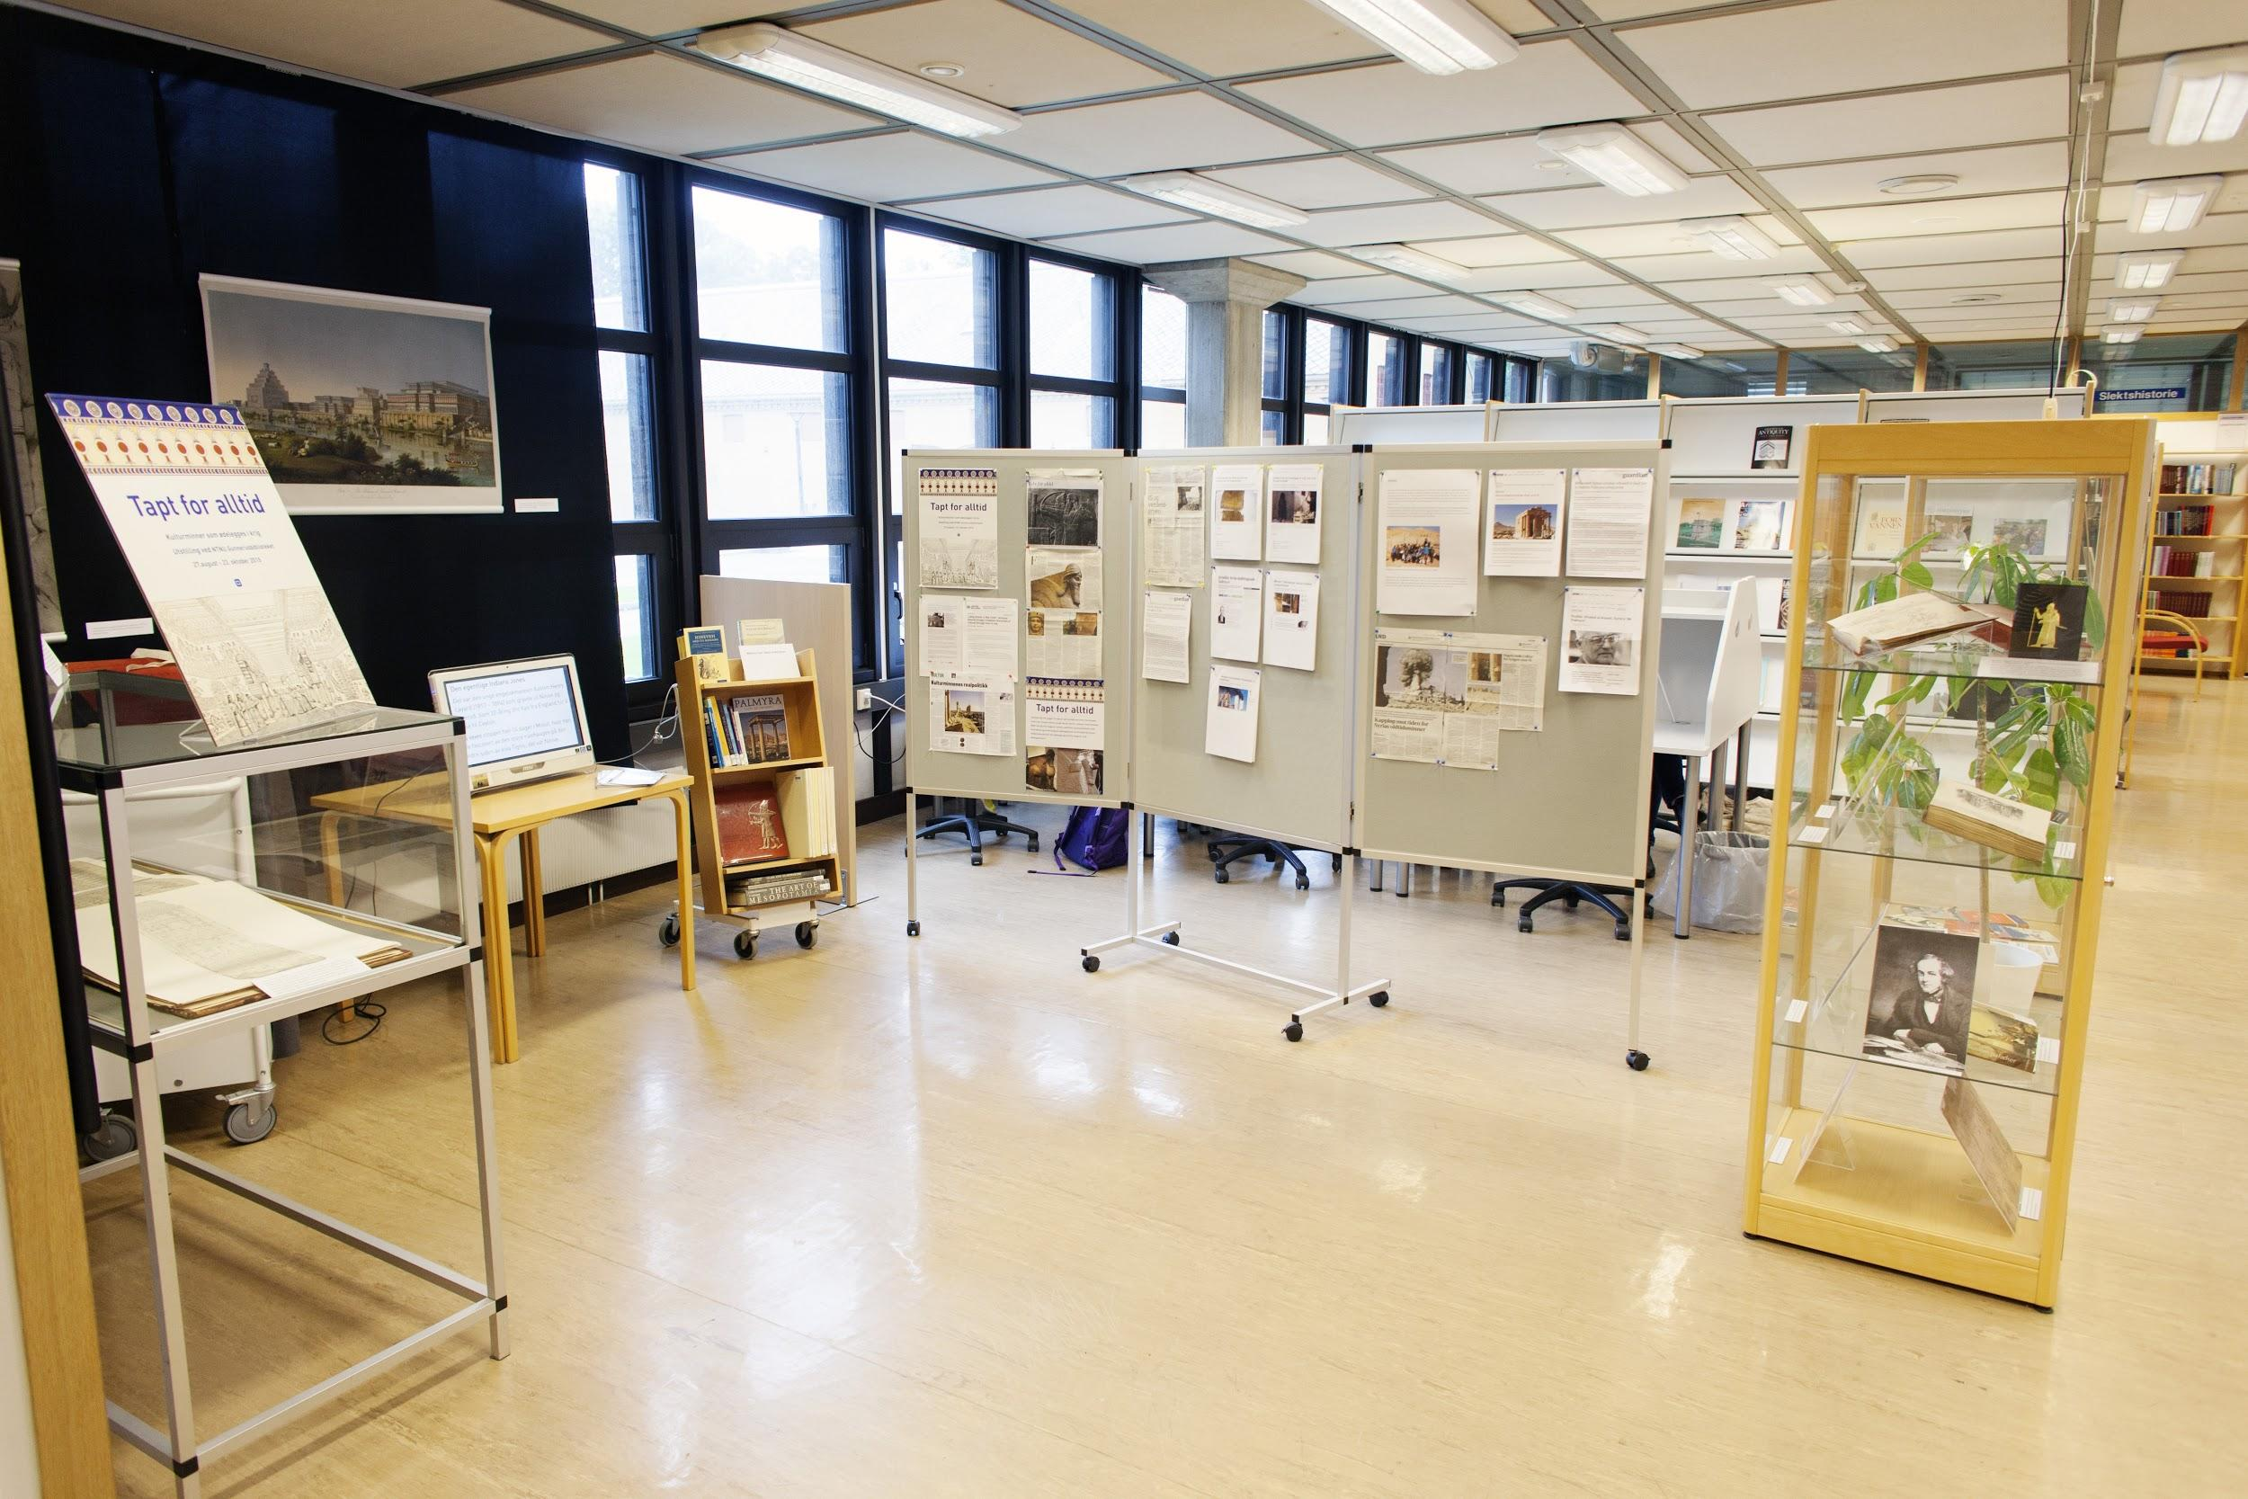
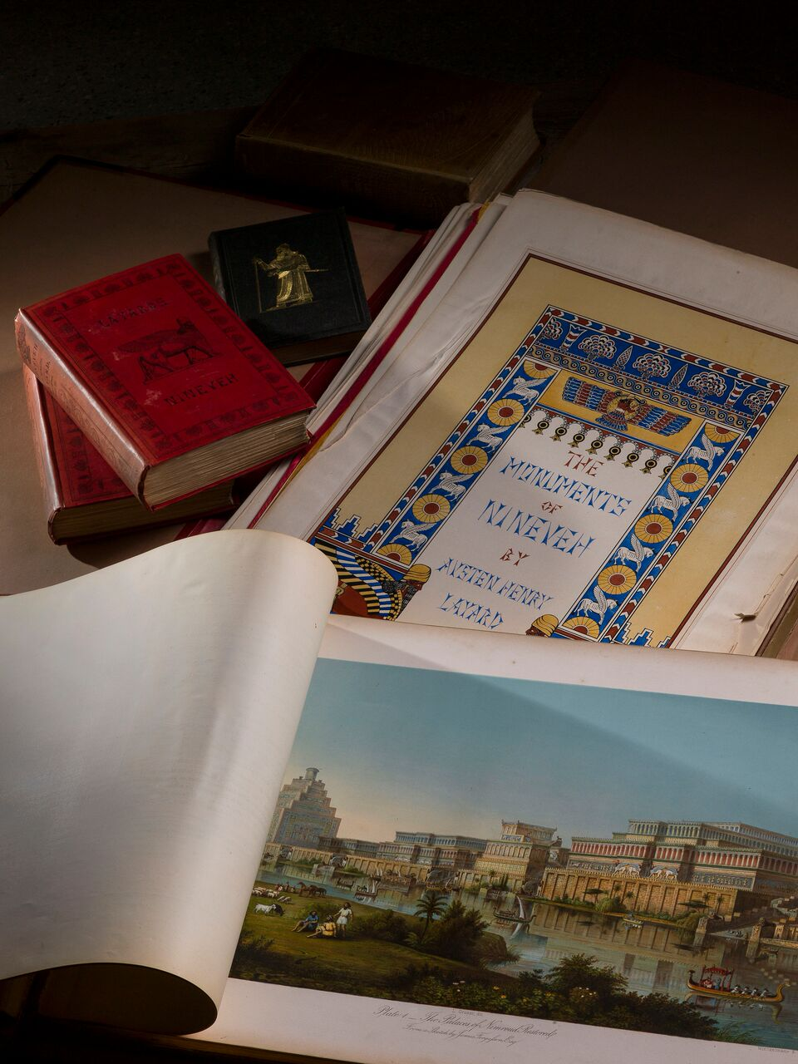
“Lost for ever”
exhibition, 2015
at the University library of Trondheim.
Notes:
Lost forever
In March 2015 destroyed the Islamic State ruins of the Assyrian cities of Nineveh and Nimrud in northern Iraq. They smashed sculptures, and other images, and the rest they destroyed with bulldozers. Nineveh was the capital of the mighty Assyrian Empire (ca. 1350-612 f.Kr). Nimrud was royal residence of the kings Assurnasipal II and his son Shalmaneser III. Nineveh and Nimrud were excavated by French and British archaeologists since 1842. A young adventurer, Englishman Austen Henry Layard, excavated from 1845 until 1851 the two cities. The sculptures and reliefs that he sent to the British Museum was a true sensation; they constituted the first glimpse of a civilization, known from the Bible, but forgotten for 2,500 years. Layard's books, 'Nineveh and its Remains' from 1849 and 'Discoveries in the Ruins of Nineveh and Babylon' from 1853 became bestsellers. These books, as well as two wall charts, 'Monuments of Nineveh', from the same period in the original editions belong to the spacial collection of the University library of Trondheim at the Gunnerus branch. They are important sources for the cultural heritage which is now destroyed.
References:
Austen Henry Layard. A Second Series of the Monuments of Nineveh: includingservers bas-reliefs from the palace of Sennacherib and Bronzes from the Ruins of Nimroud: from drawings made on the spot, during a Second Expedition to Assyria. London, John Murray, 1853. (Layard 1853)
Austen Henry Layard. The Monuments of Nineveh, from drawings made on the spot. London, John Murray, 1849. (Layard 1849a)
Austen Henry Layard. Nineveh and its Remains, vol 1-2. London, John Murray, 1849. (Layard 1849b)
Online exhibition is made by: Lise Bender Jørgensen, Inger Lango and Peggy Furter (October 2015)
Pictures by Nils Christian Eikeland.

Slide 17
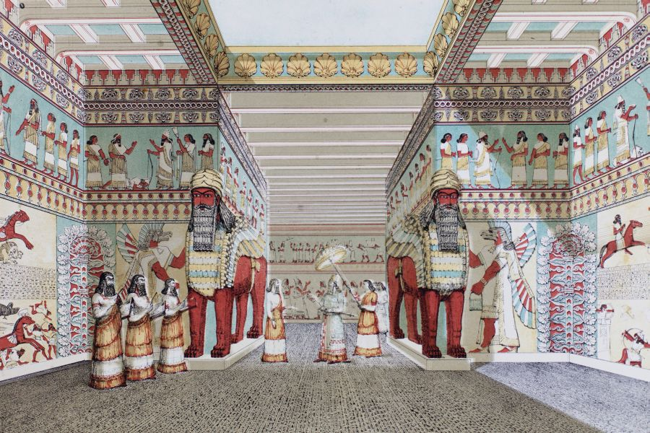
Notes:
A drawing from Hayards book.

Slide 18
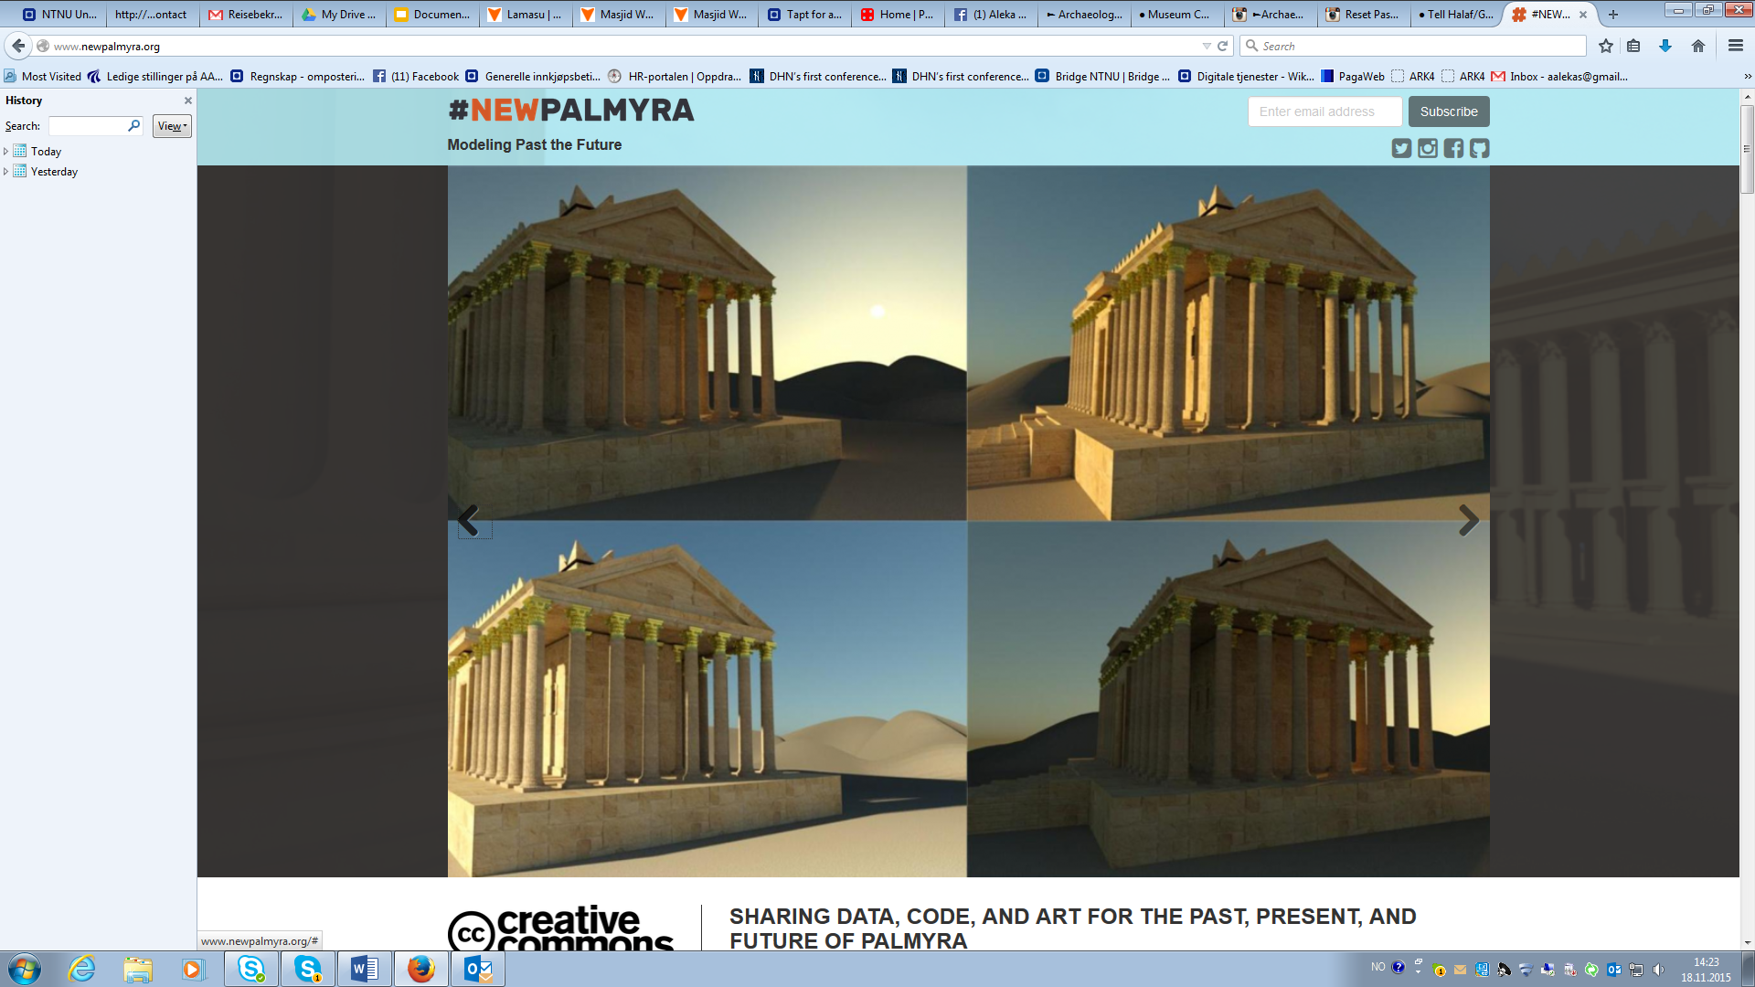
Notes:
NEW PALMYRA is a new online community platform and data repository dedicated to the capture, preservation, sharing, and creative reuse of data about the ancient city of Palmyra.The organization issued an open call for historical data and artistic work to virtually reconstruct Palmyra’s cultural heritage. The collected data will be released into the public domain under a Creative Commons Zero license at NewPalmyra.org.“For millennia, the ancient Syrian city of Palmyra was a vital crossroads of trade and culture. We are hearing the senseless destruction of this archeological treasure by ISIS as a clarion call for the world to celebrate the cultural heritage of Syria,” said Barry Threw, Interim Director of #NEWPALMYRA. “By sharing data and encouraging its use in creative explorations we hope to promote cultural understanding."The archives will launch with models based on the 3d virtual reconstruction of Palmyra started by Bassel Khartabil, a Damascus-based technologist and community organizer, and originator of #NEWPALMYRA. “Palmyra is the most important archeological site in Syria,” says Khartabil, “We hope that by honoring its memory with a virtual site of collaboration we can build a new community and highlight the plight of the Syrian people.”
http://www.newpalmyra.org/
visited 17.11.2015

Slide 19
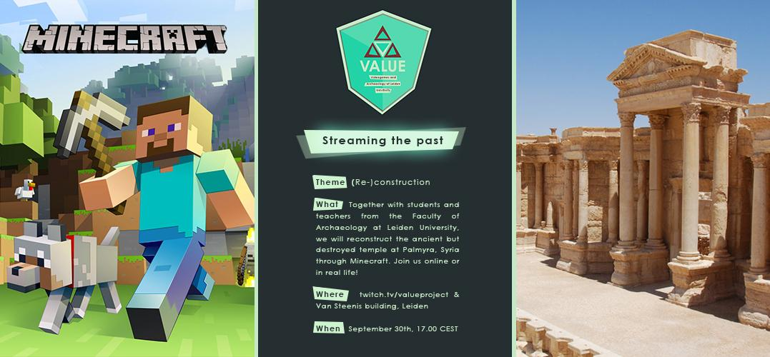

Slide 20
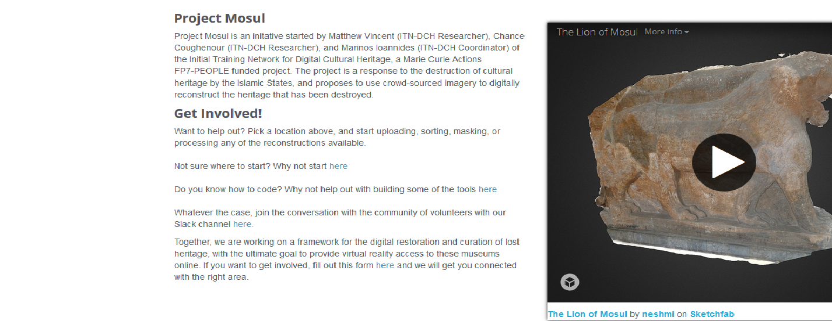
Notes:
The initiators of Project Mosul are fellows of the European Union Marie Curie programme, “Initial Training Network for Digital Cultural Heritage” (ITN-DCH). This is network of young heritage professionals of various nationalities encompasses a wide range of skills in the domain of digital cultural heritage. Working in ten different European countries, a main focus of the network is the use of 3D objects in the field of heritage management and conservation. The core team of Project Mosul, with the expertise it possesses from its training in ITN-DCH, wanted to respond quickly to the on-going cultural loss by building the tools, in the form of a web platform and masking software, that would allow for the 3D virtual reconstruction of the destroyed artefacts. This initial team is being joined daily by volunteers from around the world. These are people looking to make a positive difference in the preservation of cultural heritage. Likewise the project is growing in scope to offer its facilities for digital reconstruction for the artefacts that have been damaged or destroyed at other sites such as Hatra and Nimrud.
Project Mosul aims to avoid the rhetoric of hate with which these acts of destruction have been associated and instead wants to focus on a message of hope: by working together, it is possible to preserve our shared memory and connections to our cultural heritage, even renew and invigorate it, regardless of the acts of destruction currently being perpetrated upon it.
What the project practically proposes is to use crowd-sourced images to virtually recreate artefacts as 3D objects using the latest in photogrammetry techniques. These 3D representations will then be presented in an online museum where the data will be freely accessible to the public.
While these 3D objects can never replace the artefacts that have been destroyed, they can serve as a starting point to keep the memory of these objects and their meaning alive. The 3D objects may initially serve in helping identify stolen items and aid researchers working on the destroyed items. Virtual reconstruction is not an end in itself, however, but the start of a reengagement with the meaning of these objects. It is hoped that the virtual representations will give an additional tool to the communities that wish to think about, learn about, and work on the preservation and dissemination of these important elements of a national, regional and global history, and to return a sense of agency to those left helpless in the face of the destruction of their heritage.
Project Mosul is working closely together with other organisations, not least the local management of the Mosul Museum, but also initiatives such as the EU's 4D-Ch-World and the digital library EUROPEANA.

Slide 21
Lets work together!
“Project Mosul aims to avoid the rhetoric of hate with which these acts of destruction have been associated and instead wants to focus on a message of hope: by working together, it is possible to preserve our shared memory and connections to our cultural heritage, even renew and invigorate it, regardless of the acts of destruction currently being perpetrated upon it.”
http://projectmosul.org/, visited 17.11.2015

Slide 22
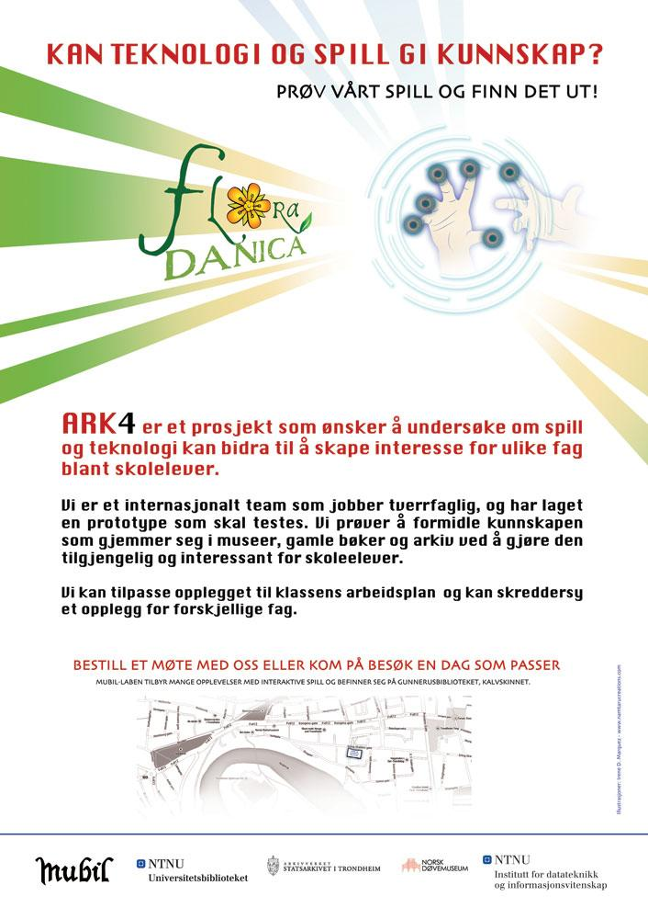
ΑRΚ4: A digital library project by the NTNU University Library of Trondheim: World monuments at risk from Europeana collections in collboration with Athena Digital Curation Unit.
Europeana Collections:
Palmyra: http://www.europeana.eu/portal/search.html?query=Palmyra&rows=24
Baalshamin: http://www.europeana.eu/portal/search.html?query=Baalshamin&rows=24
Dura-Europos http://www.europeana.eu/portal/search.html?query=Dura-Europos+&rows=24
Bosra http://www.europeana.eu/portal/search.html?query=Bosra&rows=24
Other Collections:
Red List Syria: http://icom.museum/uploads/tx_hpoindexbdd/ERL_SYRIE_EN.pdf
Heritage for peace: http://www.heritageforpeace.org/latest-news/9-out-of-10-world-heritage-sites-are-in-danger/
UNESCO World Heritage in danger http://whc.unesco.org/en/danger/
Dura Europos http://arachne.uni-koeln.de/arachne/index.php?view[layout]=bauwerk_item&search[constraints][bauwerk][searchSeriennummer]=2105240
Notes:
ARK4 is a project that will create a game platform for archaeology students where archaeological sites in danger will be one of the subjects to be presented. This is a project initiated by the NTNU University library of Trondheim in collaboration with Athena digital curation unit in Athens. The project is financed by NTNU and the National library of Norway.
read more here http://mubil.no/avada_portfolio/flora-danica/

Slide 23
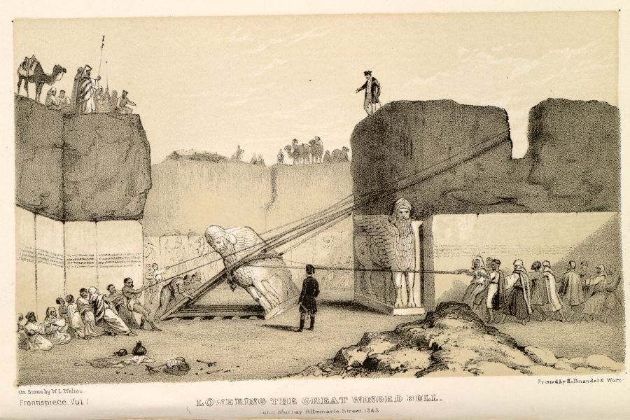
There is no resurrecting the individuals killed by Islamic State’s cold cruelty and calculated killing, but defaced and destroyed objects could find a second life. The world has a history of cultural resuscitation.
Markos Kounalakis is a print and network broadcast journalist and author who covered wars and revolutions, both civil and technological.
he is involved in the New Palmyra project.
Notes:
Conclusion
In all the above projects visualization has been chosen as a main tool to create engagement, as you noticed I tried to avoid showing videos or pictures of damaged antiquities. All decided to use visualization for two reasons one for documenting and two proactively as to the objects that are stolen and could be sold in the market. I have deliberately chosen to show the pictures and websites that create hope and stage actions instead, of just condemning an action of destruction since sharing in Facebook has been covering this.
I agree with Omur Harmansah from the Illinois university “that the archaeological community around the world has been limiting themselves in a weak response of the stereotypical expression of dismay”. Isis he says has choreographed the videos of destruction and has reached thousands by being shared by so many in the social media. It has managed to produce imagery of violence and at the same time endorse he circulation of antiquities in global markets.
This global industry is supported and sustained by the increasing demand for illicit antiquities around the world.We need then to develop tools to respond to such a super modern phenomenon as Isis collectively and responsibly. Some of the projects I presented here actually do that?
From: https://www.researchgate.net/publication/281843261_ISIS_Heritage_and_the_Spectacles_of_Destruction_in_the_Global_Media, visited 17.11.2015
What are we willing to do? I hope that this intiative of creating a group of people in the nordic countries can give an answer to that.

