Slide 1
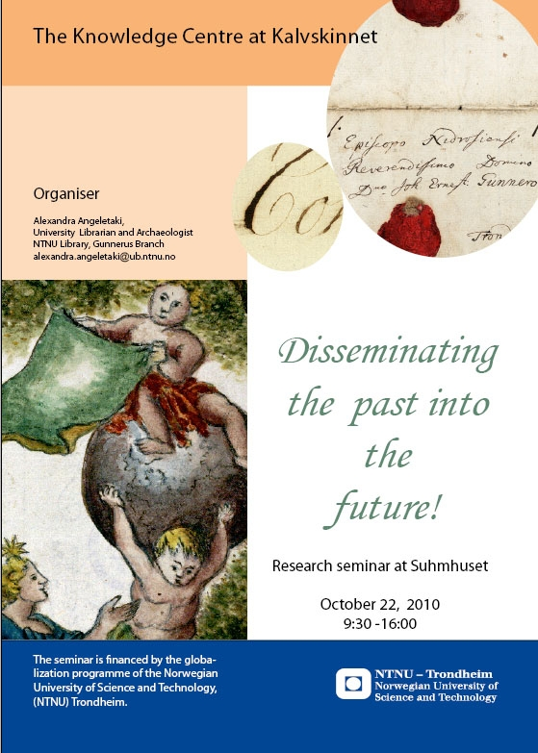
Mubil : A digital laboratory
NTNU University Library, Gunnerus branch
Project period: 1.10.2011-1.10.2013
Project manager: Alexandra Angeletaki
Collaborators:
Letizia Jaccheri, Department of Computer and Information Science (IDI), NTNU TRONDHEIM
PERCRO - Scuola Superiore, Sant'Anna, Via Martiri 11,56127, Pizza, Italy
Marcello Carrozzino and Chiara Evangelista.

Slide 2
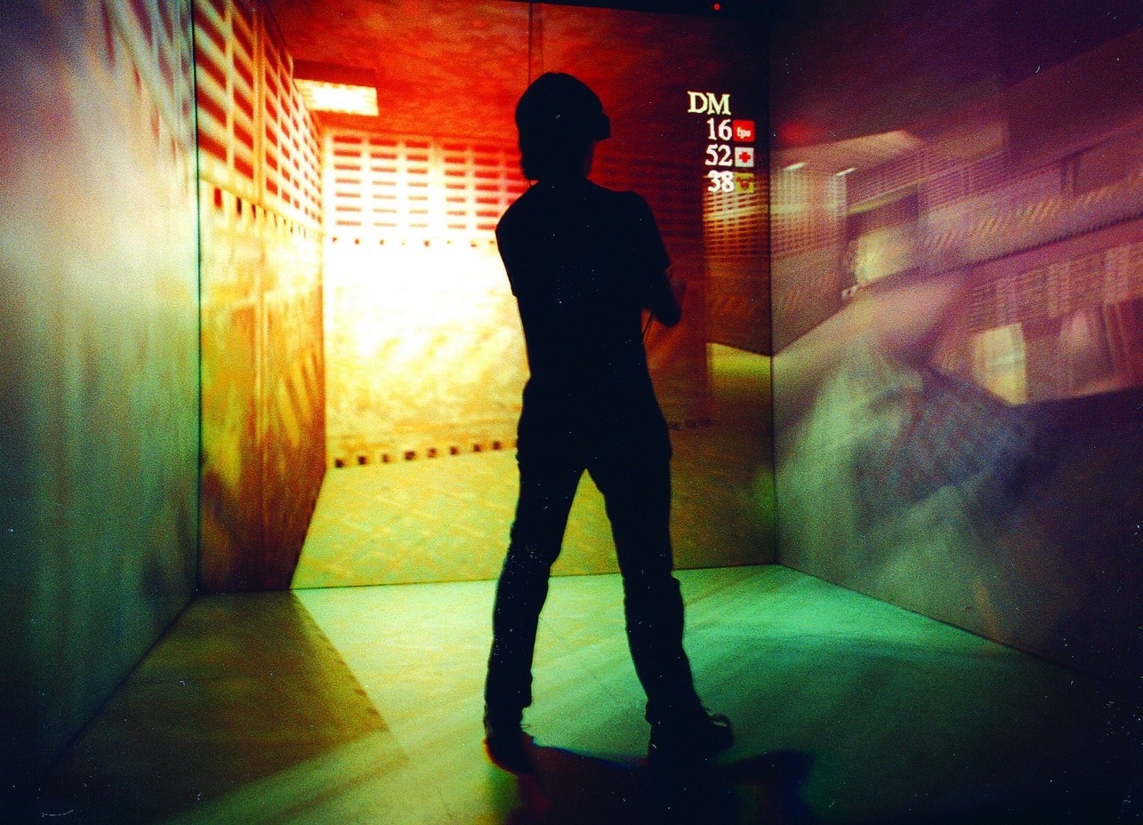
Augmented books
3D technology-XVR
Interactive tools

Slide 3
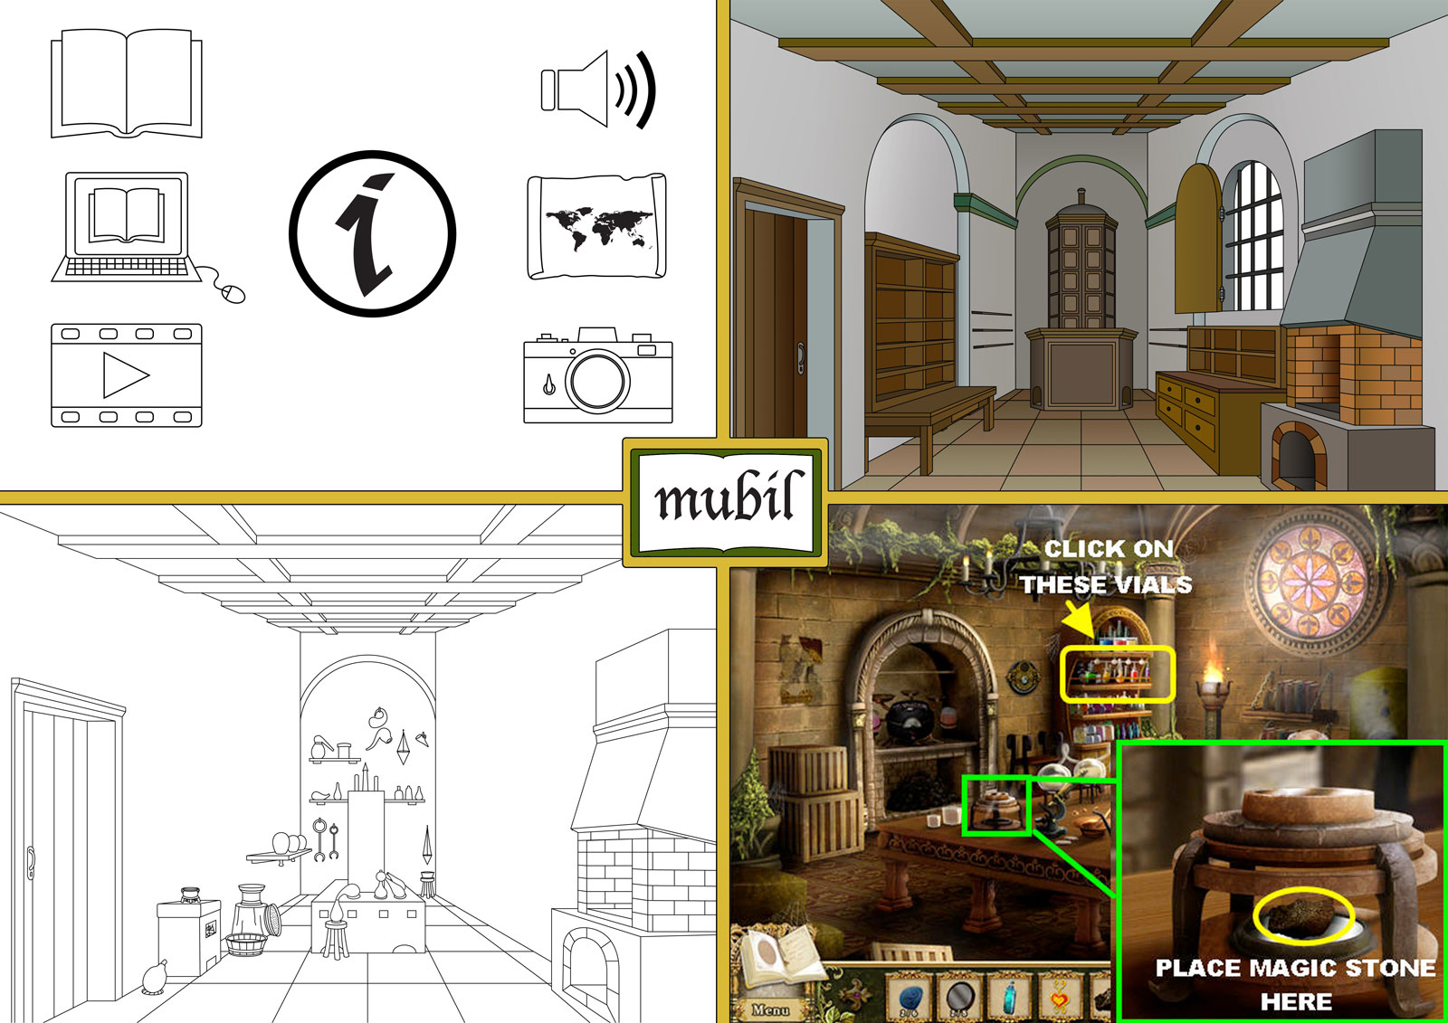

Slide 4
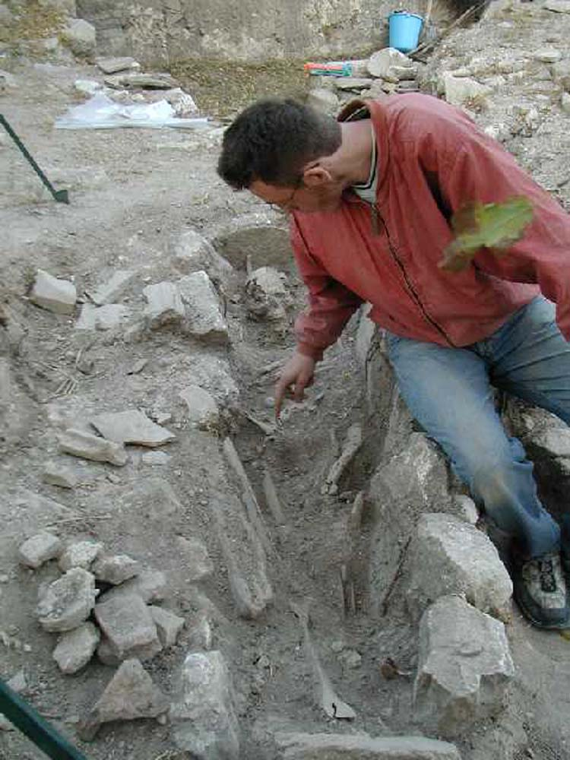
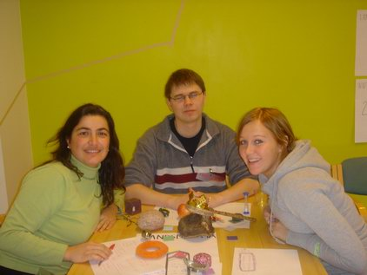
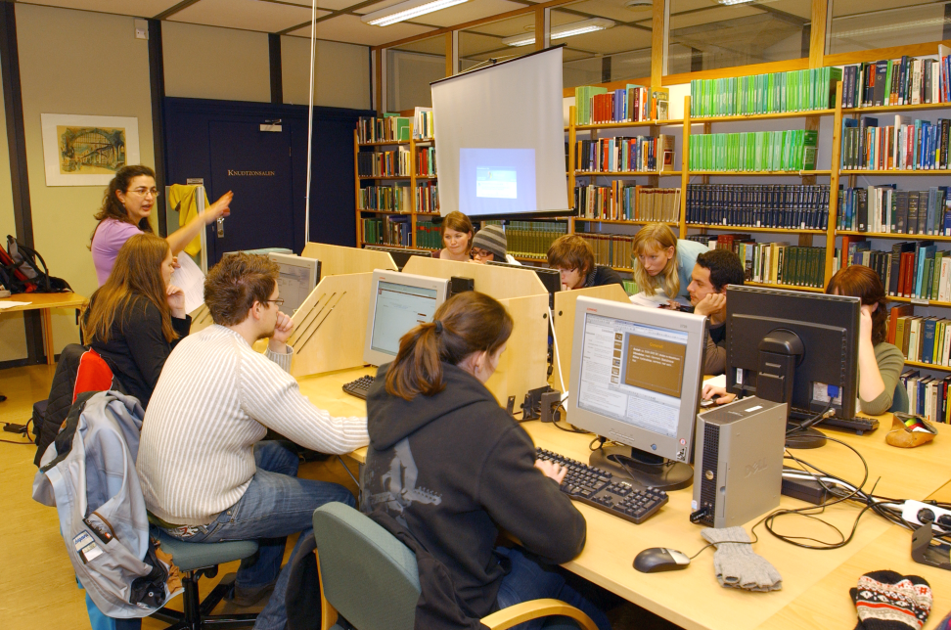
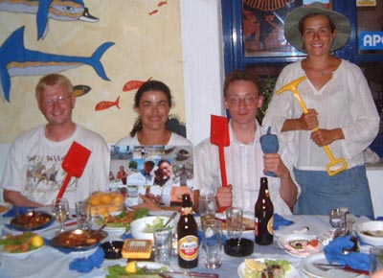
Min bakgrund

Slide 5
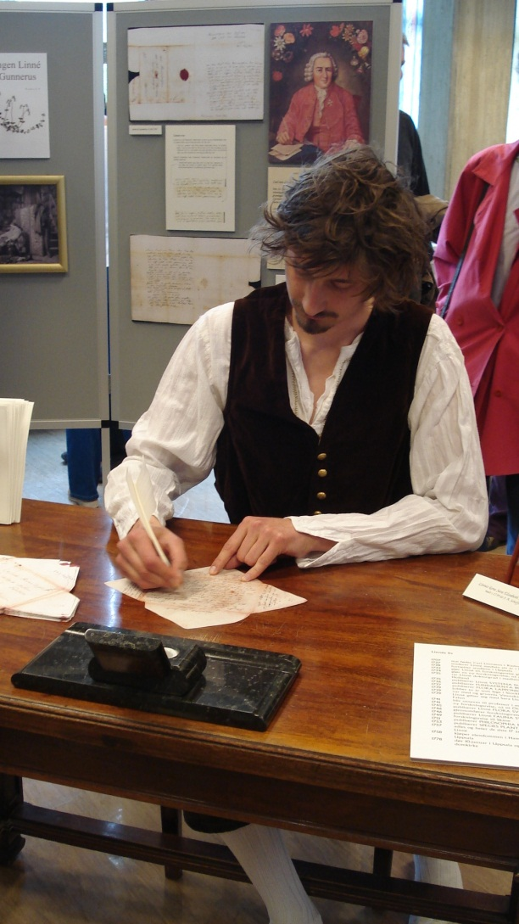
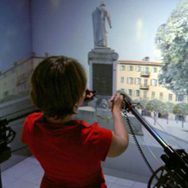
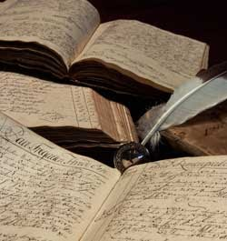
ny teknologi-gammelt innhold

Slide 6
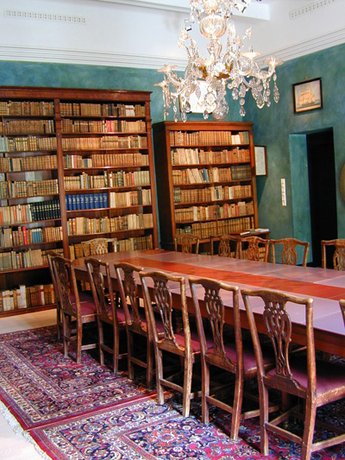
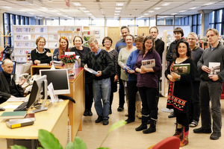
Gunnerus library in Trondheim
Notes:
Ved Gunnerusbiblioteket finnes det en god del historisk arkivmateriale og fra DKNVS virksomhet og samlinger og 400.000 bilder med portretter og landskaper fra Trondheim og omegn. Mye av det er tilgjengelig via vår databaser. For mer info se: http://www.ntnu.no/ub/spesialsamlingene/
Gunnerus libary owns a great collection of historical archives and 400.000 pictures from the area around the city. Yoy can purchase our collectuon through our website.

Slide 7
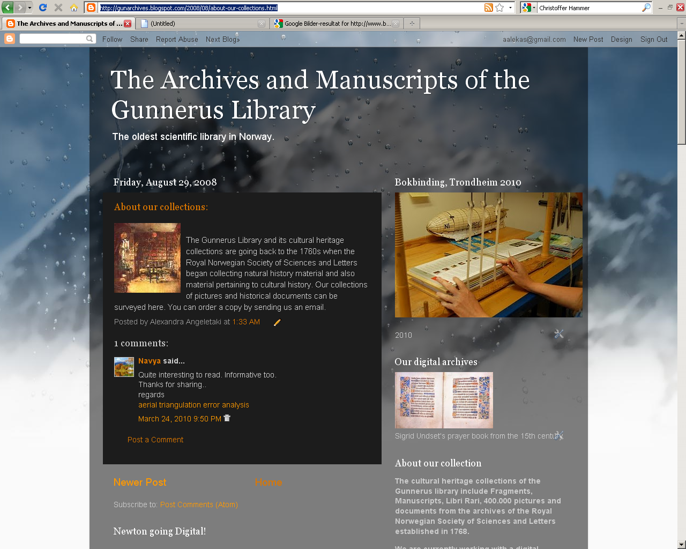
Notes:
The trnsformationof the physical objects to digital or 3d objects brings in our times through technology a new dimension to exoeriencing Knowledge.

Slide 8
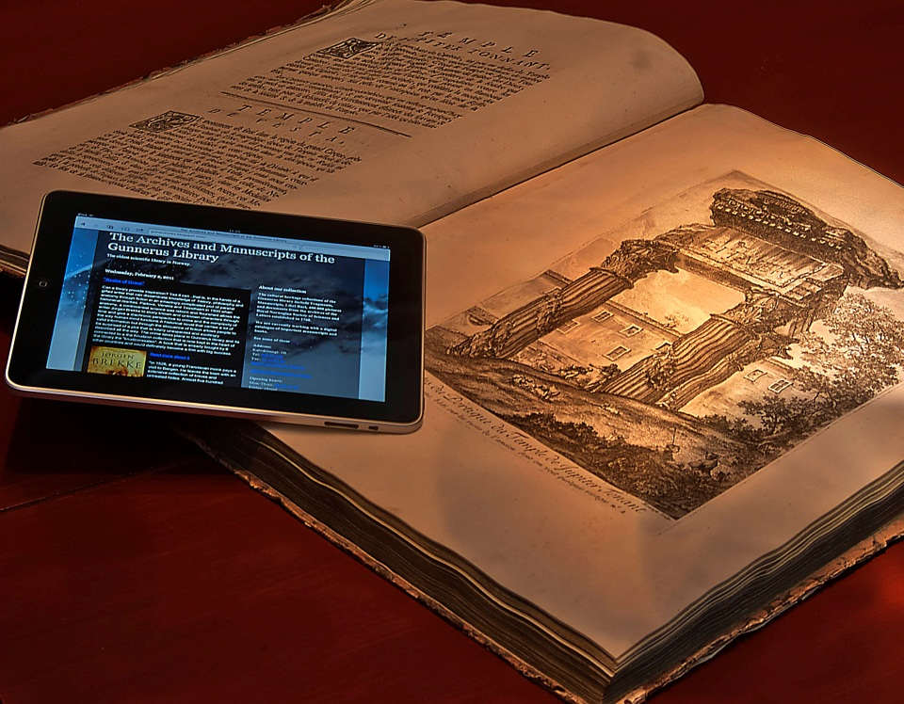
Virtuell biblioteket
Pergamenter
Manuskripter
Bøker
Kart
Arkiv
Museumsgjenstander
Bilder
Videoer
Skjønnlitteratur

Slide 9
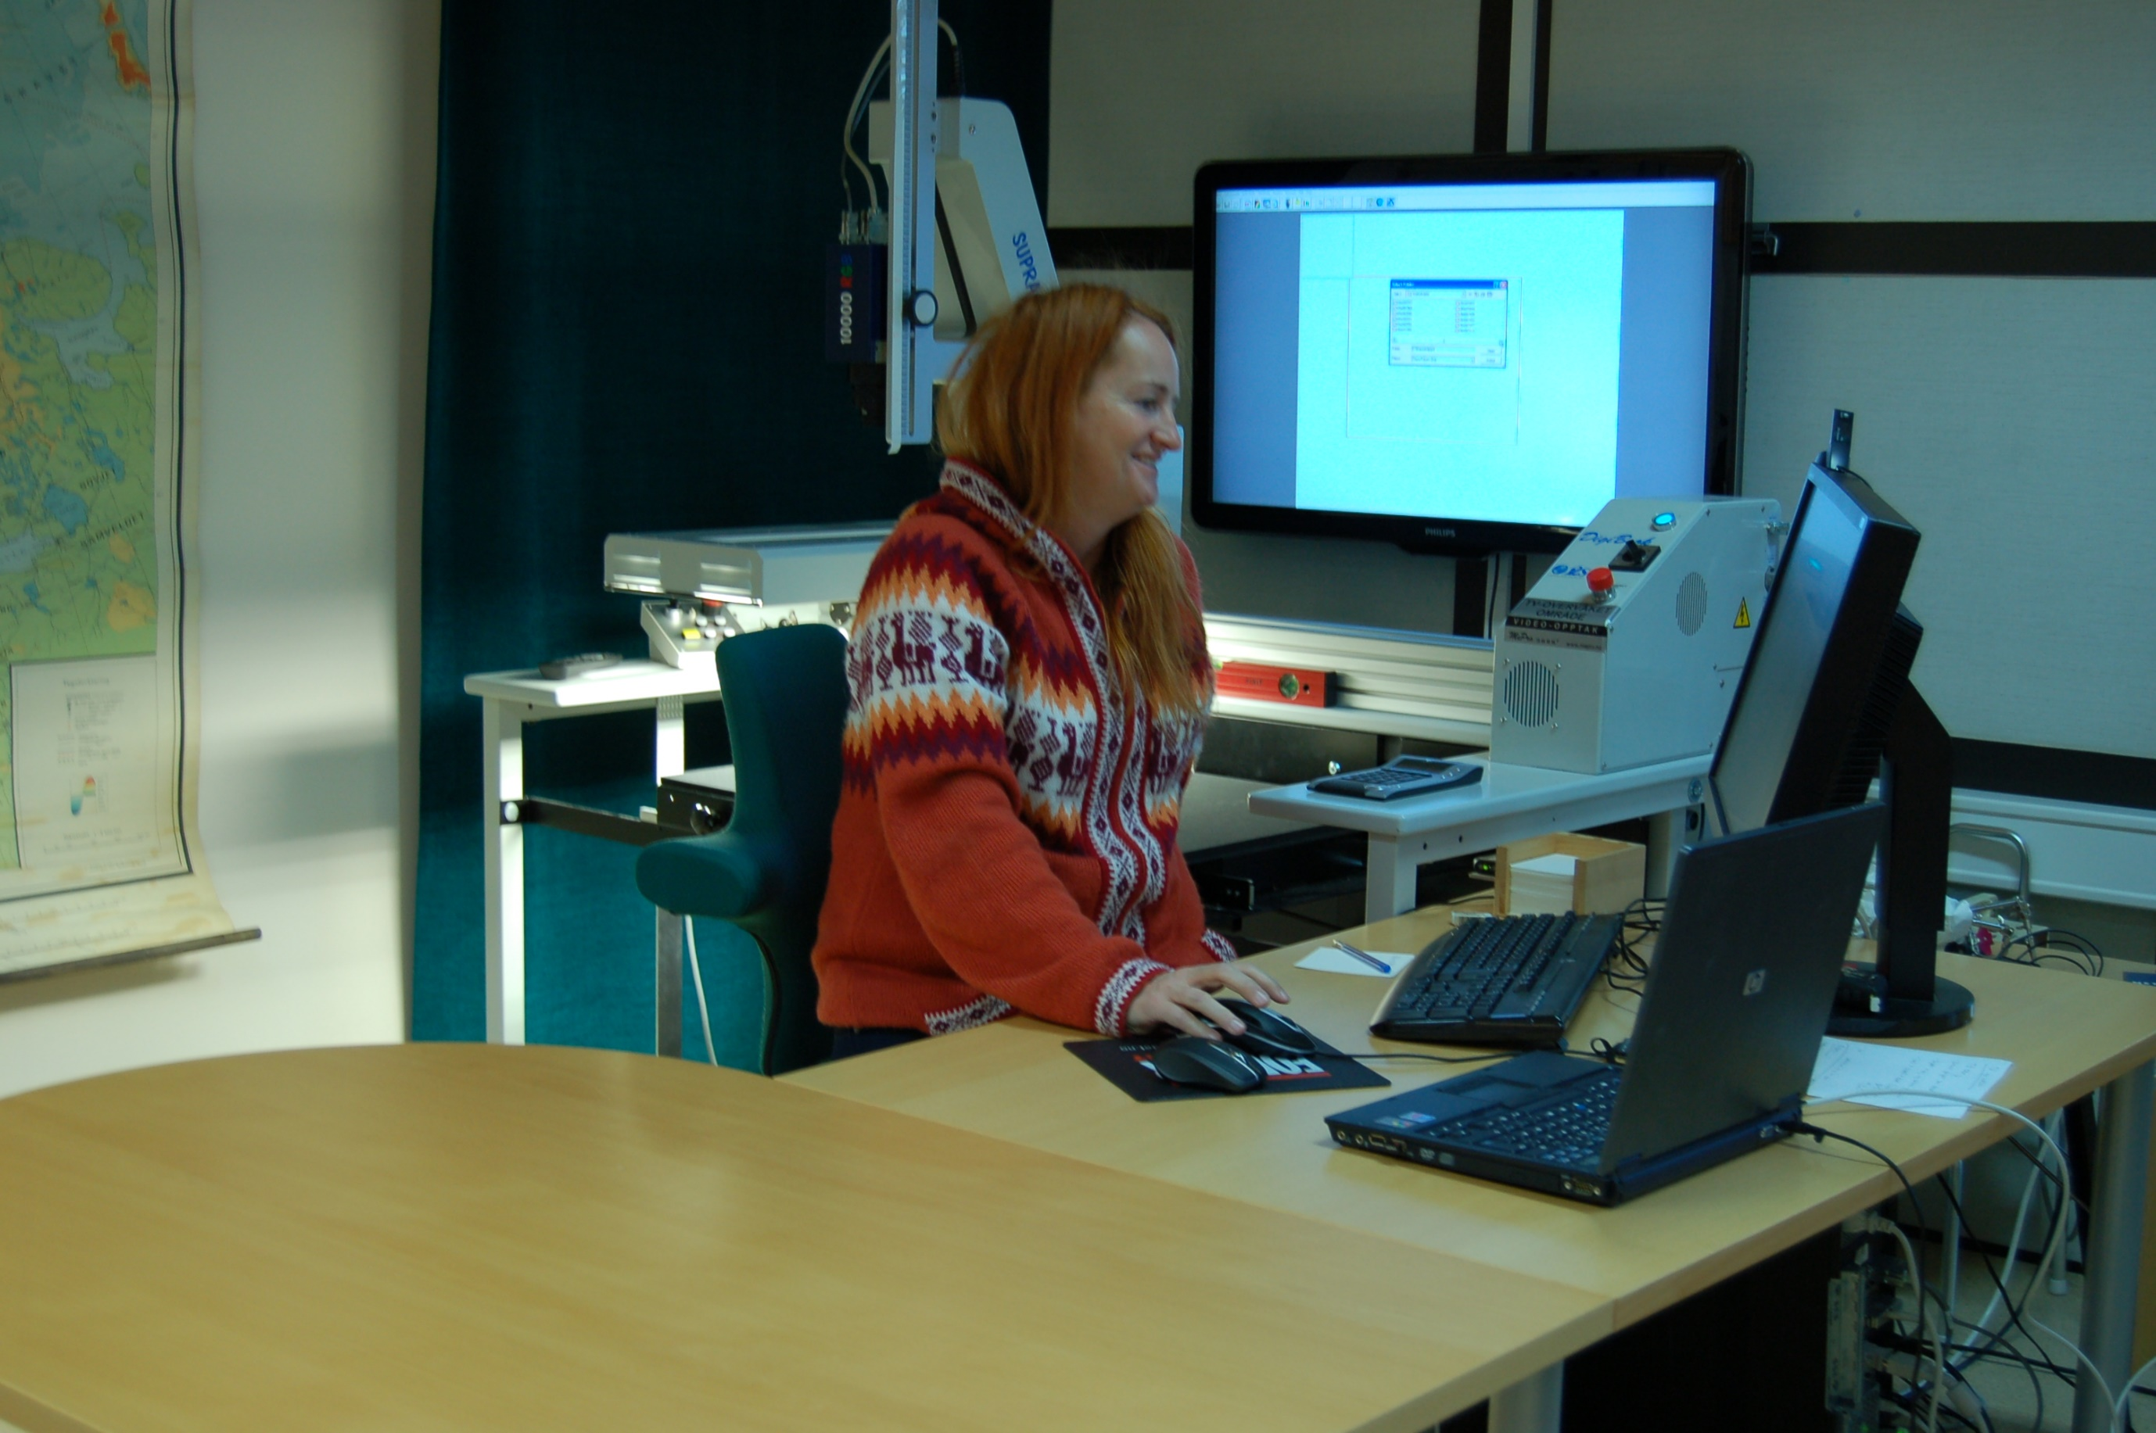
Historier som skal fortelles

Slide 10
Notes:
Hans Hanssen Lilienskiol 1650-1703
Reisejournal 1670

Slide 11
Verkstedet

Slide 12
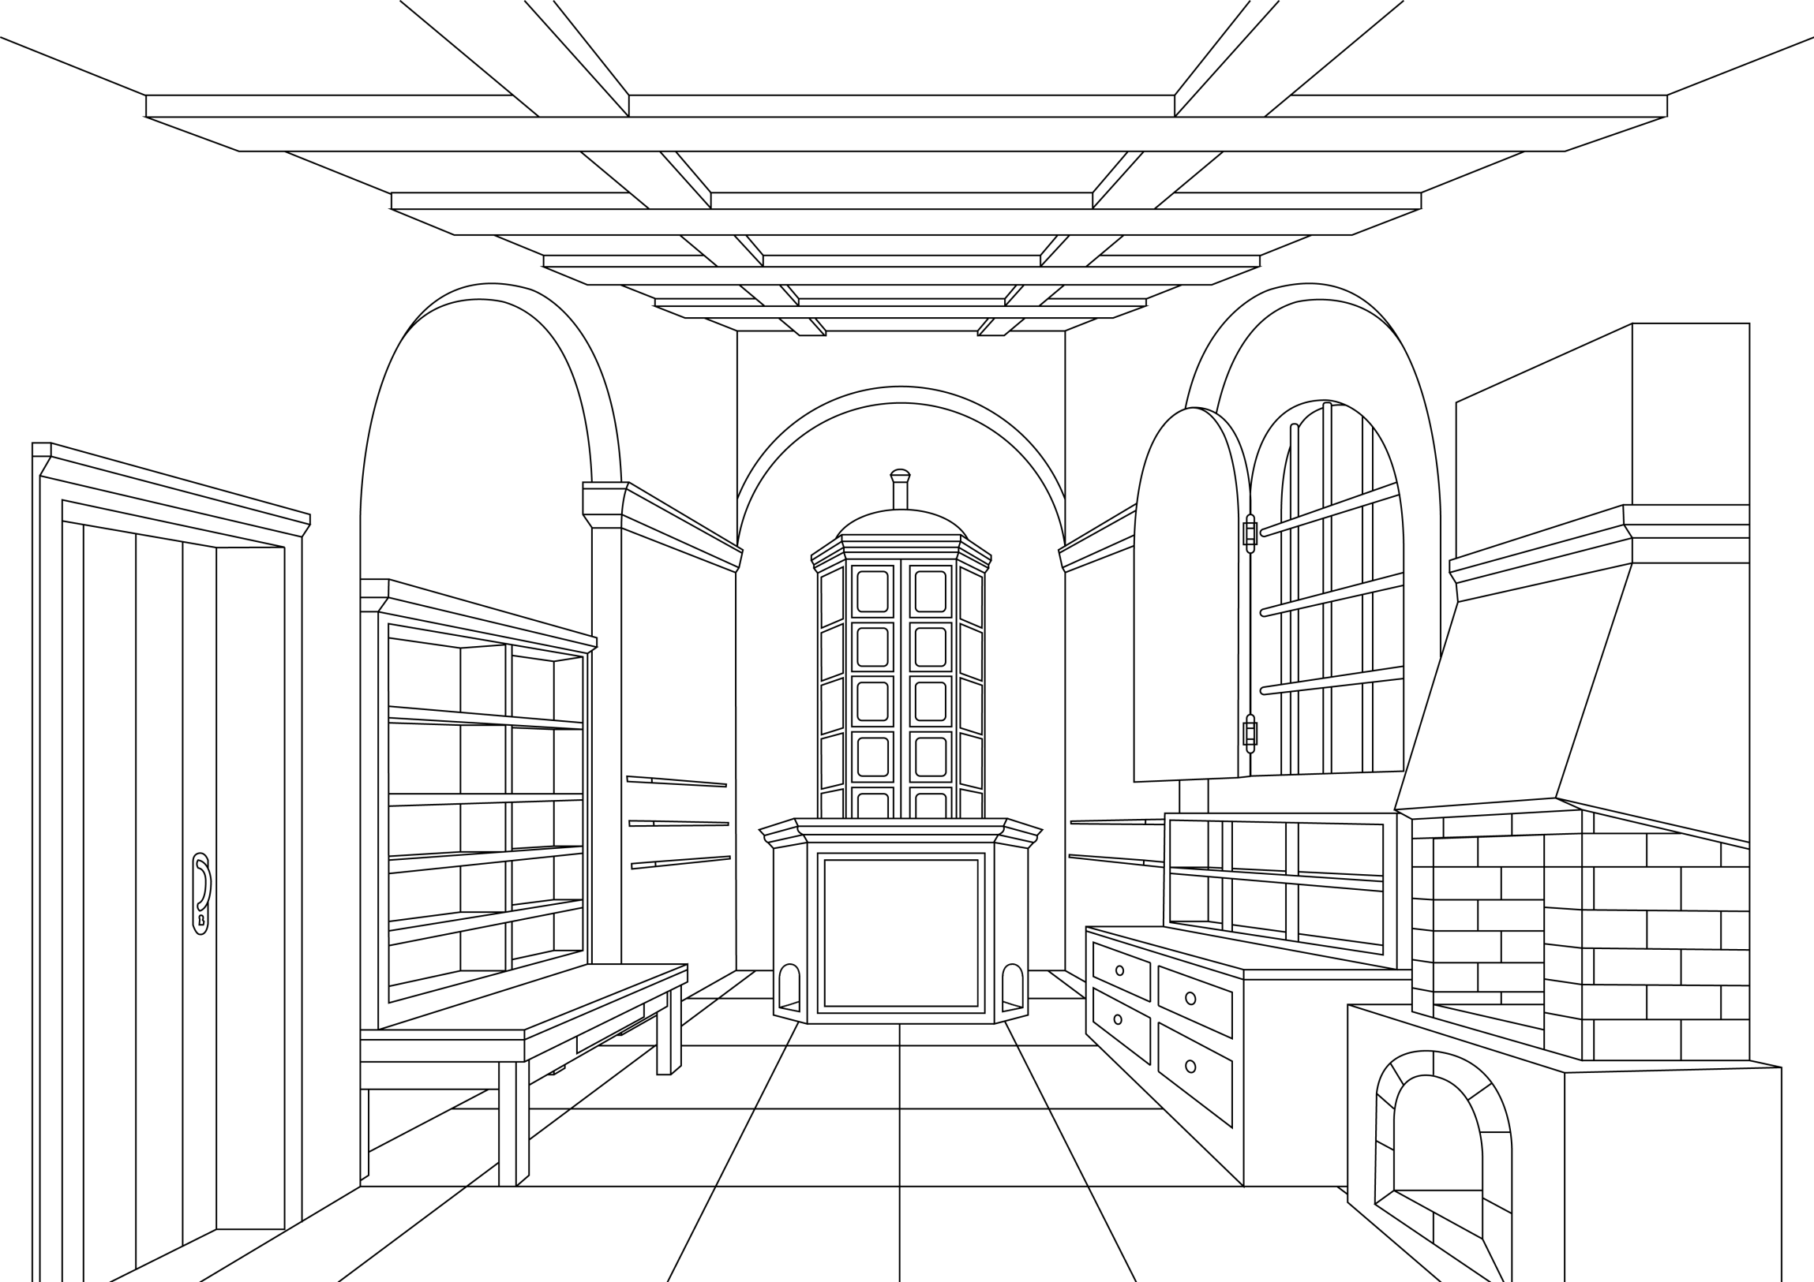

Slide 13
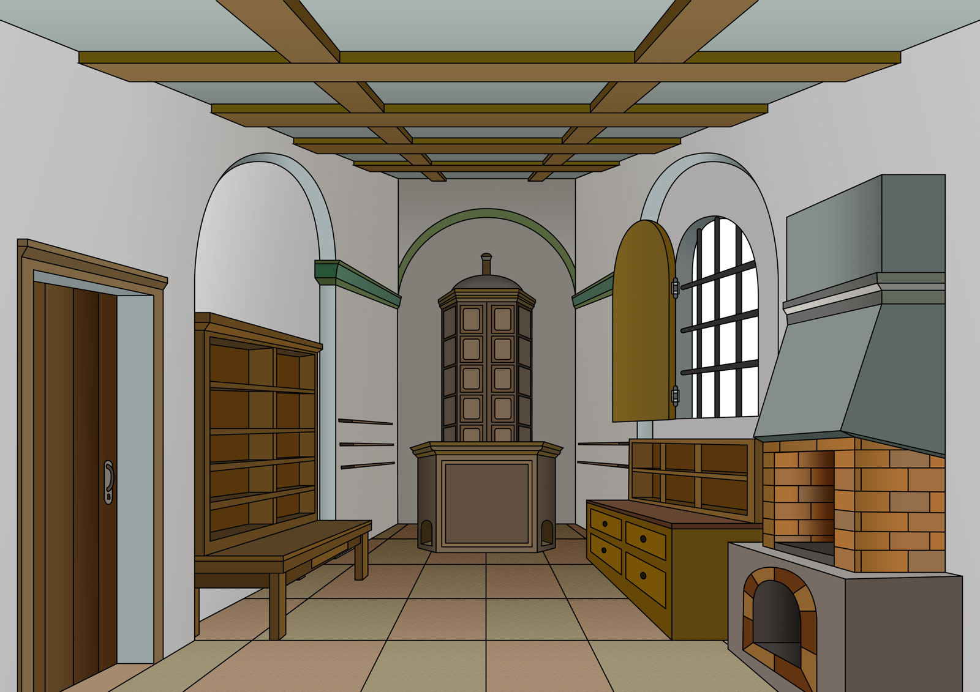

Slide 14
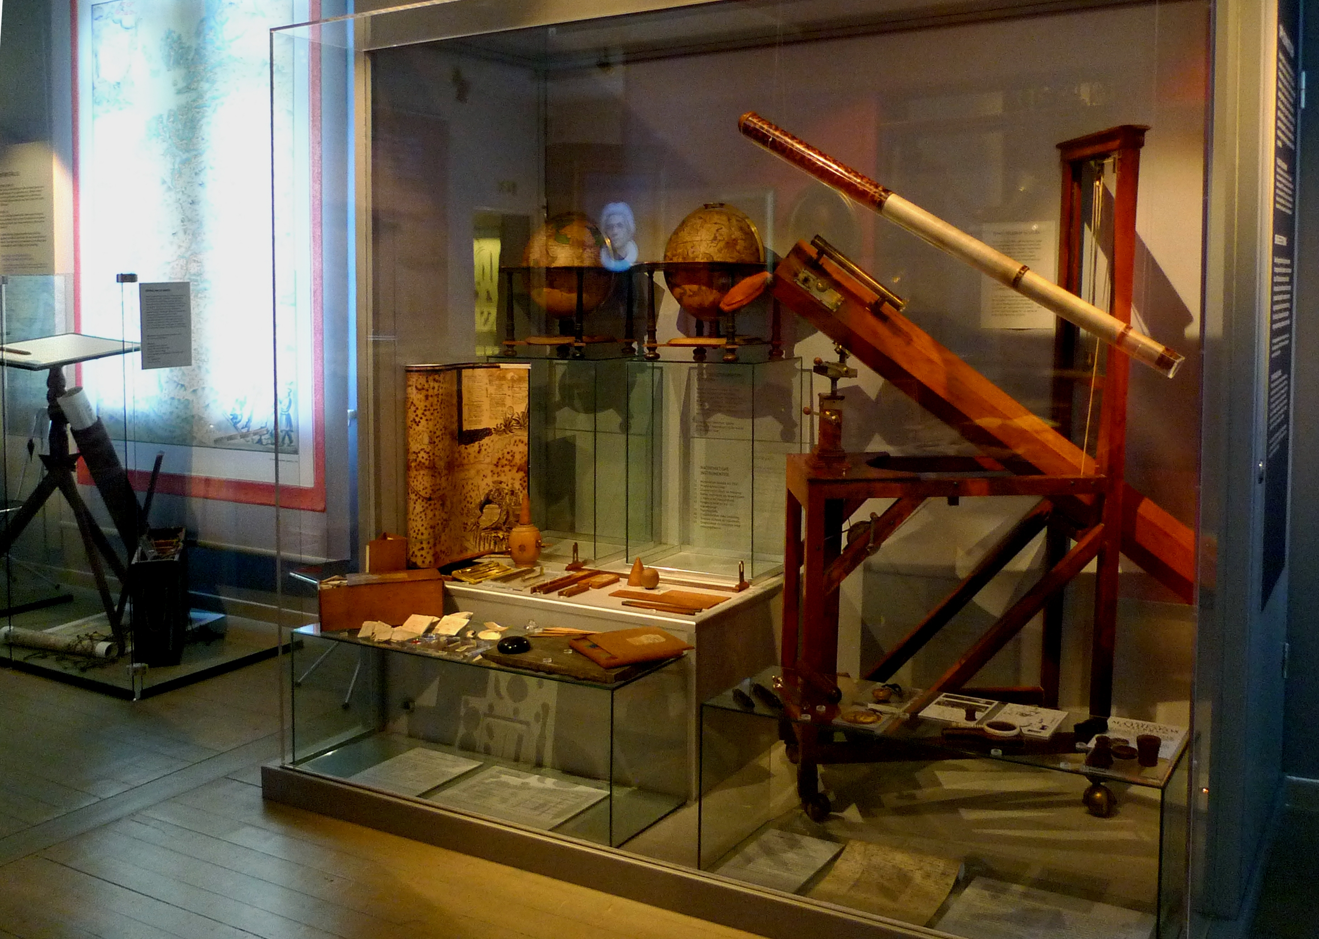
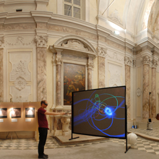

Slide 15
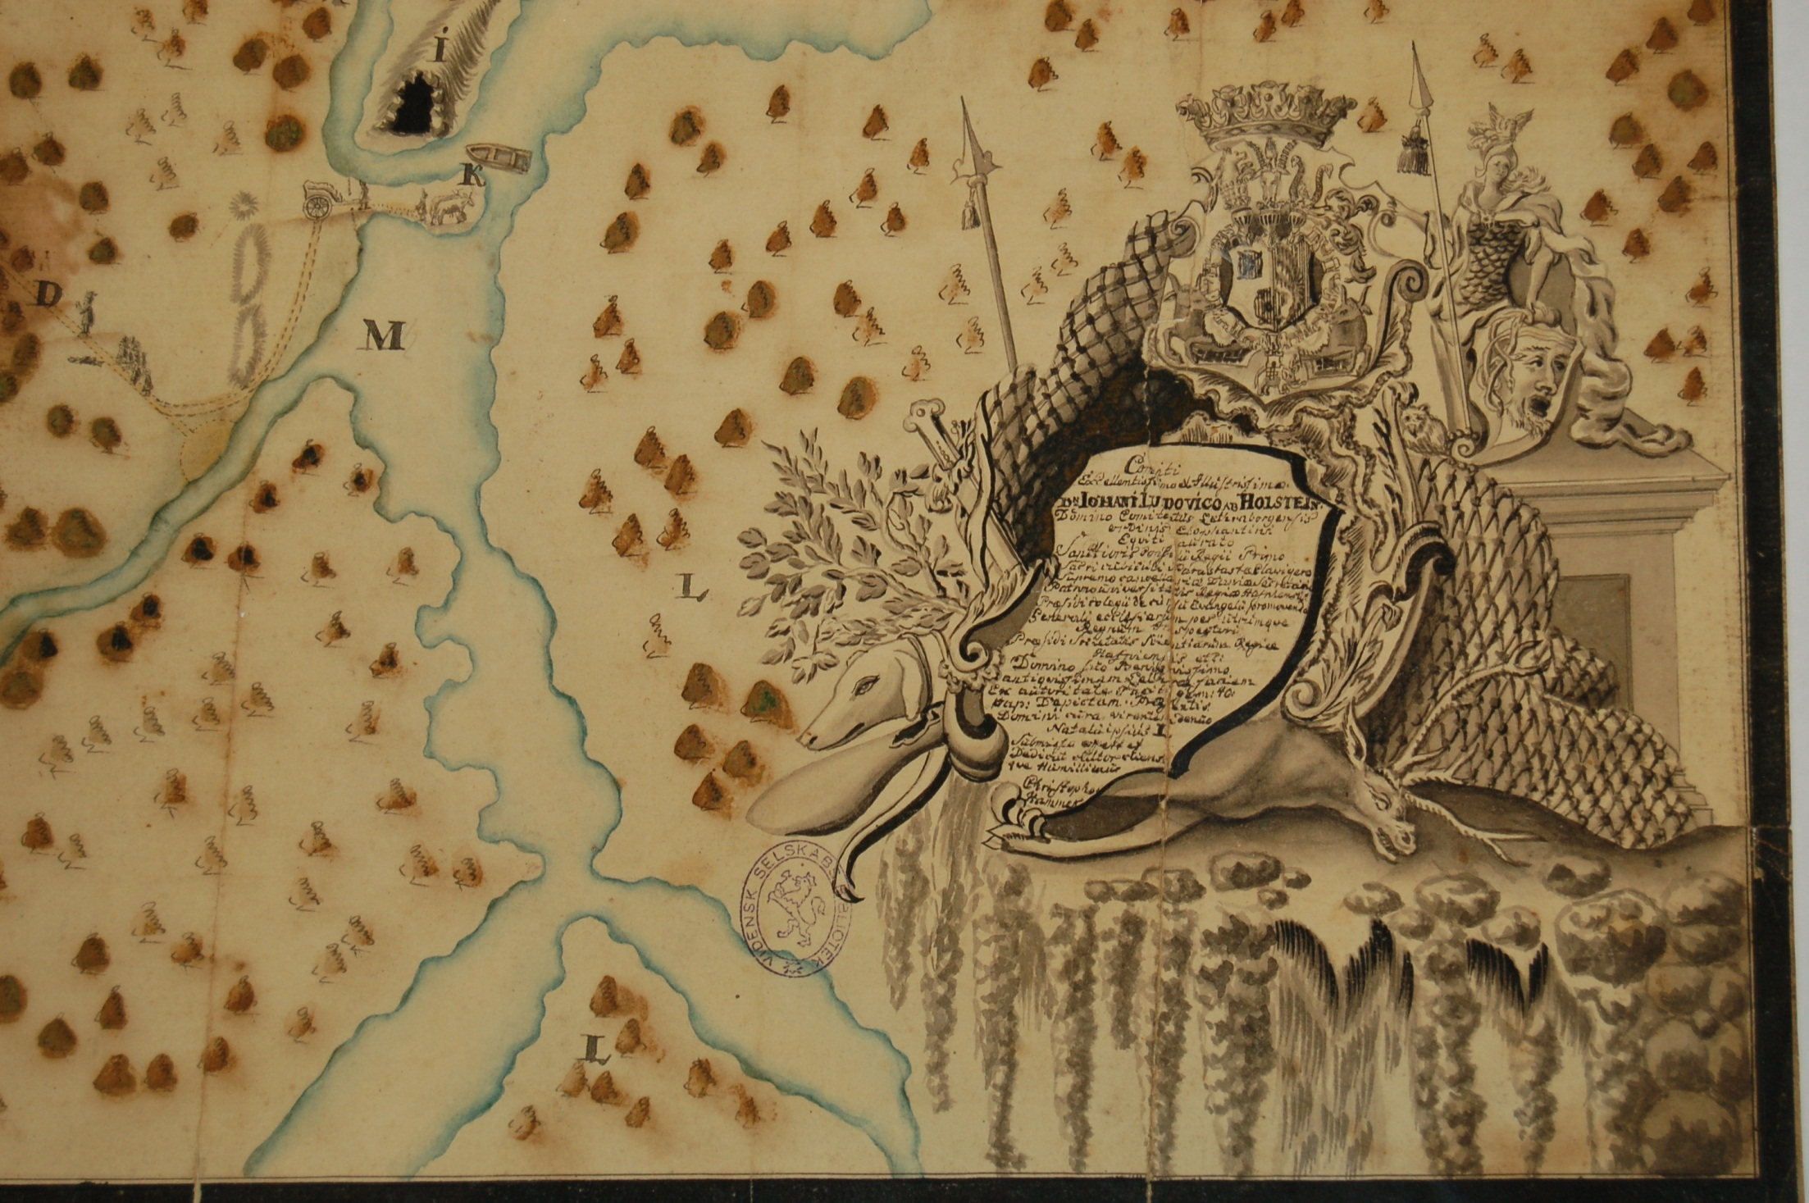

Slide 16

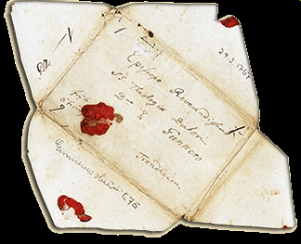

Slide 17
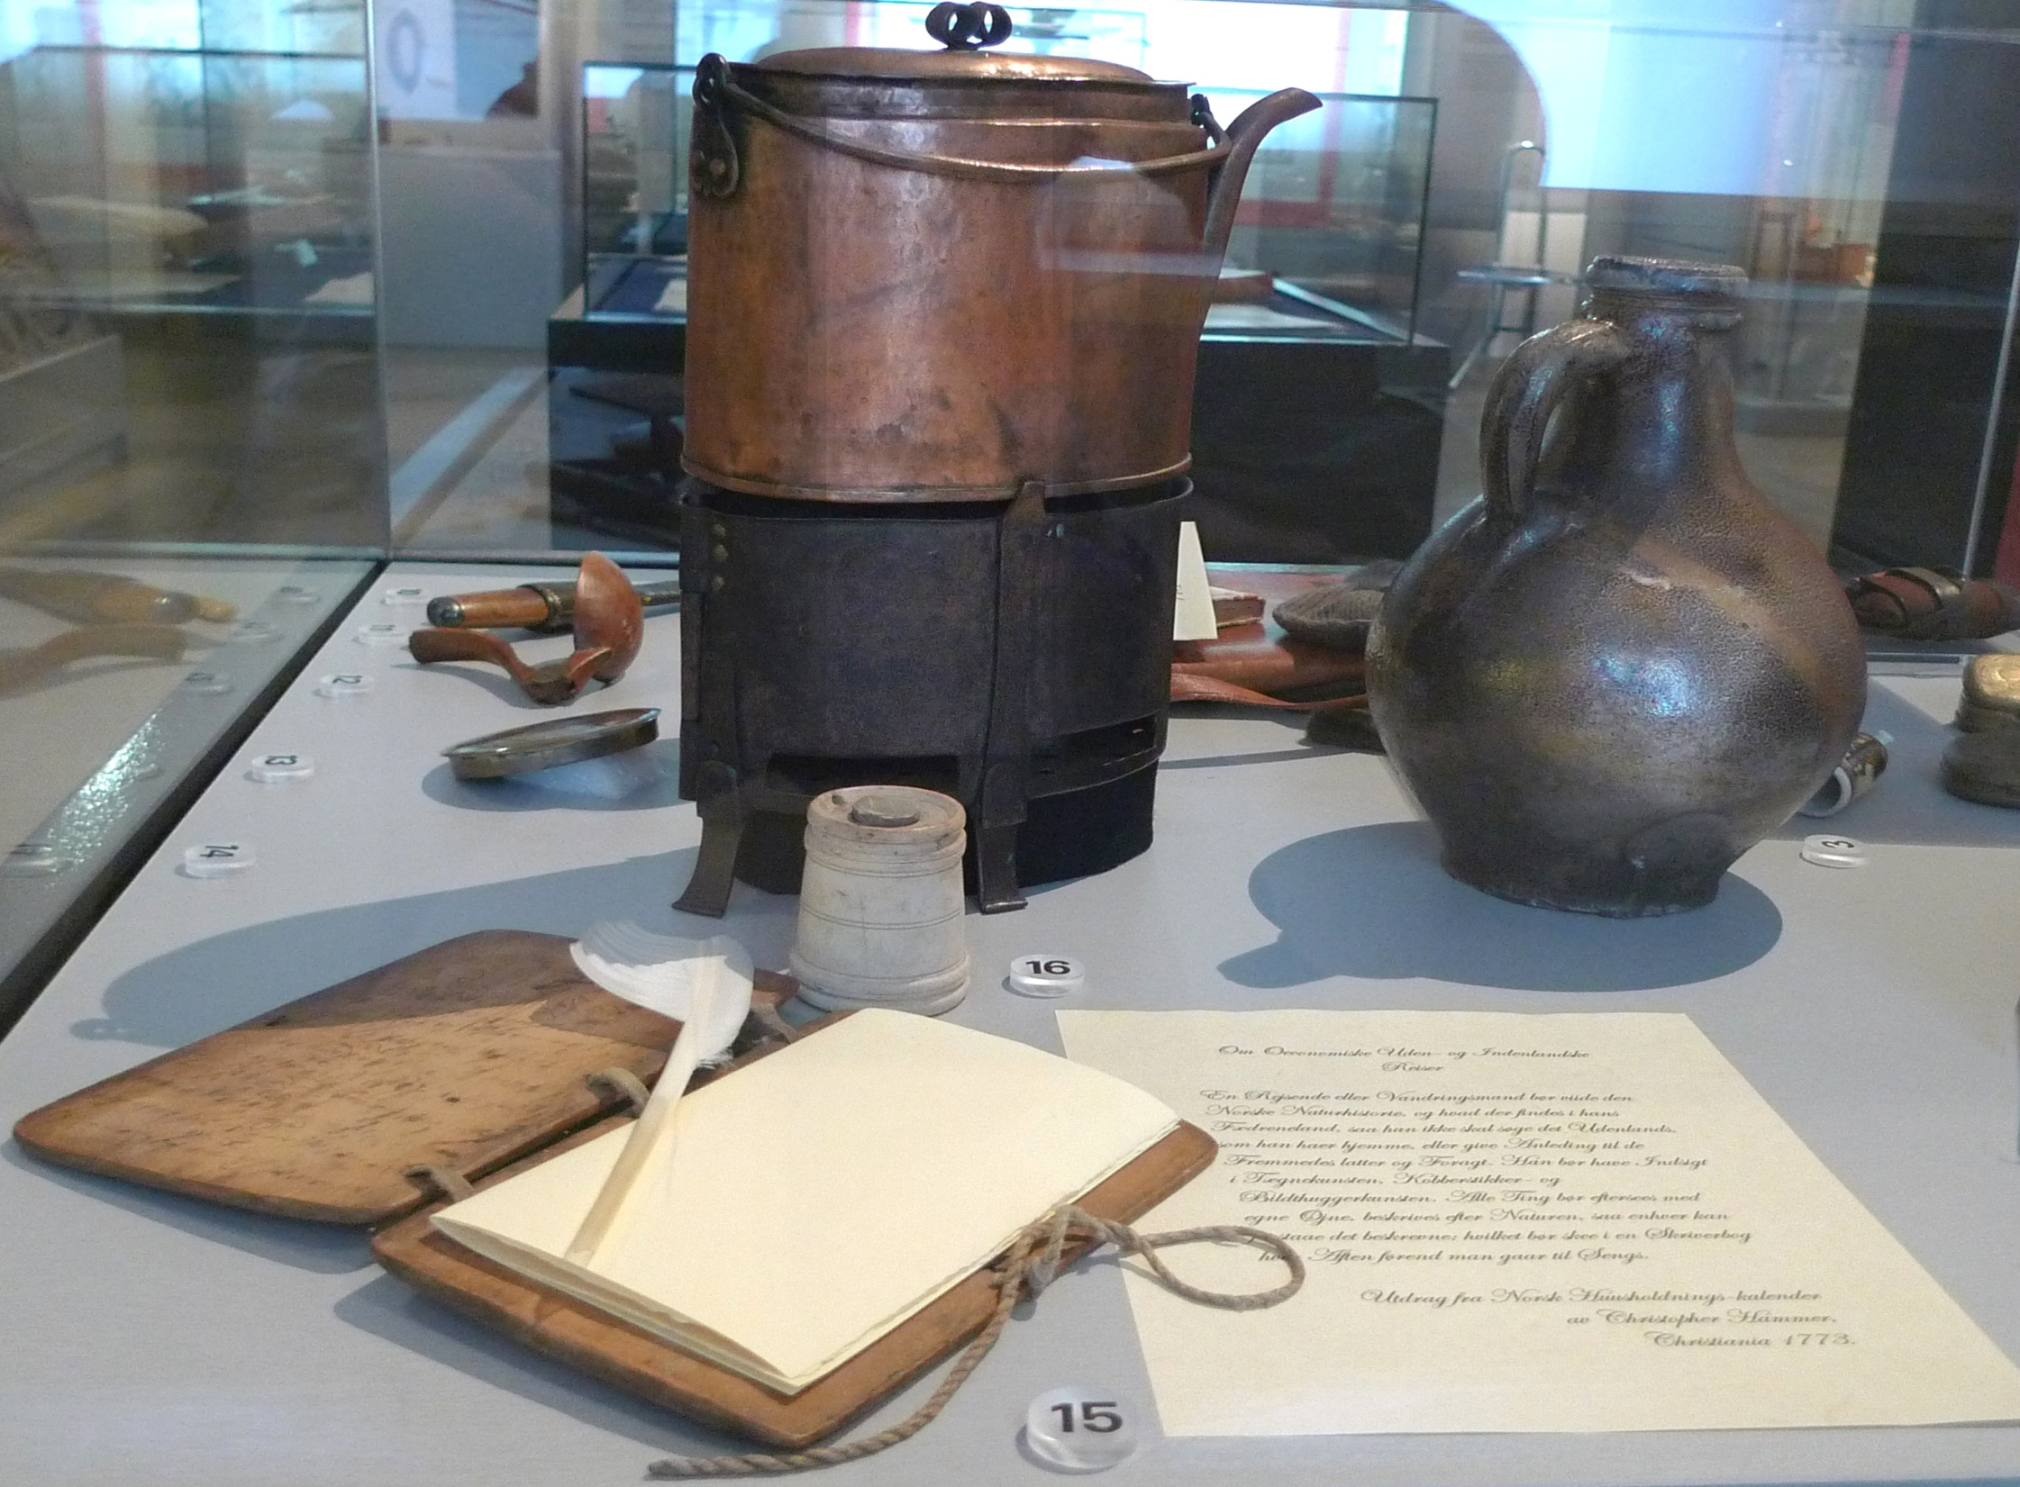
Notes:
1720-1804

Slide 18
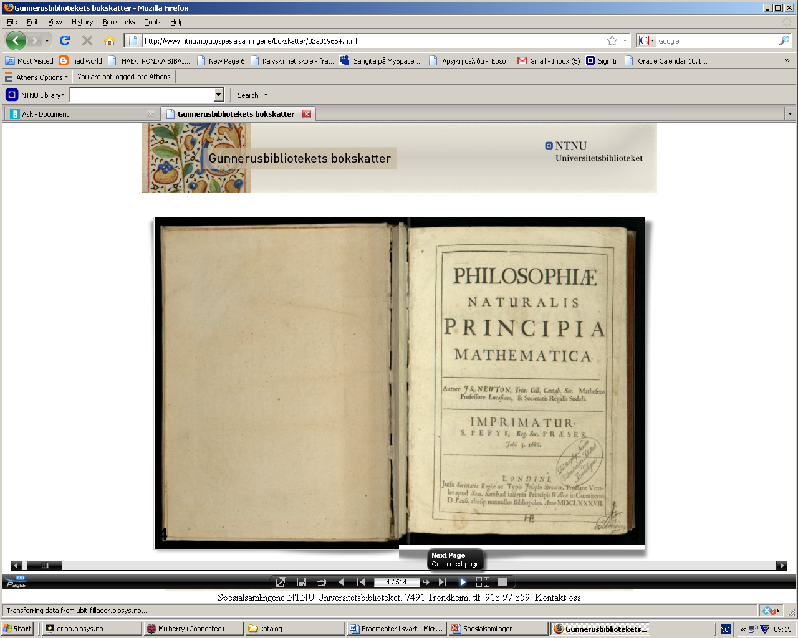
bokskatter
Gunnerus: Flora Norvegica
Newton Philosophiae Naturalis
Notes:
http://www.ntnu.no/ub/spesialsamlingene/bokskatter
Newtons Principia Mathematica from 1685 will be presented tomorrow at the celebration of the 250 years of the Royal Norwegian Academy of Sciences and letters in Trondheim.
This book ended up in Trondheim as a book of the DKNVS collections as one of a kind since the 250 copies that were then printed were very quickly sold out. Library's edition of the Principia Mathematica is probably the very own of Bishop Gunnerus who established DKNVS in 1760.
Before the bishop came to Trondheim and founded the Trondhjemske Company, later called the Royal Norwegian Society affirmation, he sojourned in Halle in the period 1742-1744 and for a longer period then in 1744-1758, in Jena, and one can speculate whether it was under this period in Halle and Jena that he bought this book. When Gunnerus died in 1773 leaving behind him a large debt, his large private library was therefore sold. In the auction catalog it says Gerhard Schøning bought Newton's Principia Mathematica.
The book is considered to be an outstanding scholarly work for the developments in physics and astronomy and the 17th century sciences, and there are hardly any other work in physics, which are similar to that in importance. The work describes the theory that later became known as Newton's laws of motion, which laid the groundwork for classical mechanics and also Newton's universal gravitation theory.
Zoom in the book here
The establishment of the library that is today called Gunnerus library belongs to the history of the DKNVS. The library today has initiated aprogram of digitization of its most valuable books, manuscripts and archives and is developing a open platform where its valuable documents can be accessed by the public. Using "Erez" one can actually browse through the book and zoom inn its pages and thus enjoy all the details as if one was holding the book in his hand.http://gunarchives.blogspot.com/2010/03/upcoming-events.html

Slide 19
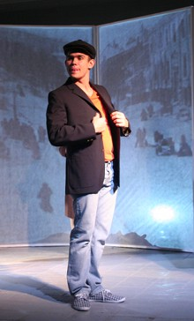
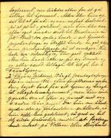
Hvordan kan historiene fortelles?
A bruke arkiv til ungdomsskoler
Notes:
Prosjektet har som m�l � formidle arkivmateriale og kulturarv til ungdom i en kunstnerisk form. Arkiv forbindes gjerne med gamle, t�rre, st�vete papirer fra fortiden. Hva har de med dagens ungdom � gj�re? Arkivene inneholder spor av menneskers liv, mennesker som deg og meg. Ogs� vi havner etterhvert i arkivene. Vi kan bruke arkivene til � finne informasjon om oss selv og v�r historie, men vi kan ogs� bruke dem for � dokumentere rettigheter eller unders�ke hva offentlige etater har gjort med skattepengene v�re. Gjennom � lage teater basert p� hendelser fra fortiden �nsker vi � sette fokus p� arkivene som kulturell og demokratisk ressurs. Og vi �nsker at flere skal ta den ressursen i bruk - arkivene er til for oss alle. Forestillingen bygger b�de p� de unges egne erfaringer og historiske kilder vi har funnet om forskjellige mennesker i arkivet. P� denne m�ten knytter teateret sammen fortid og kulturarv med samtid og ungdomskultur.

Slide 20
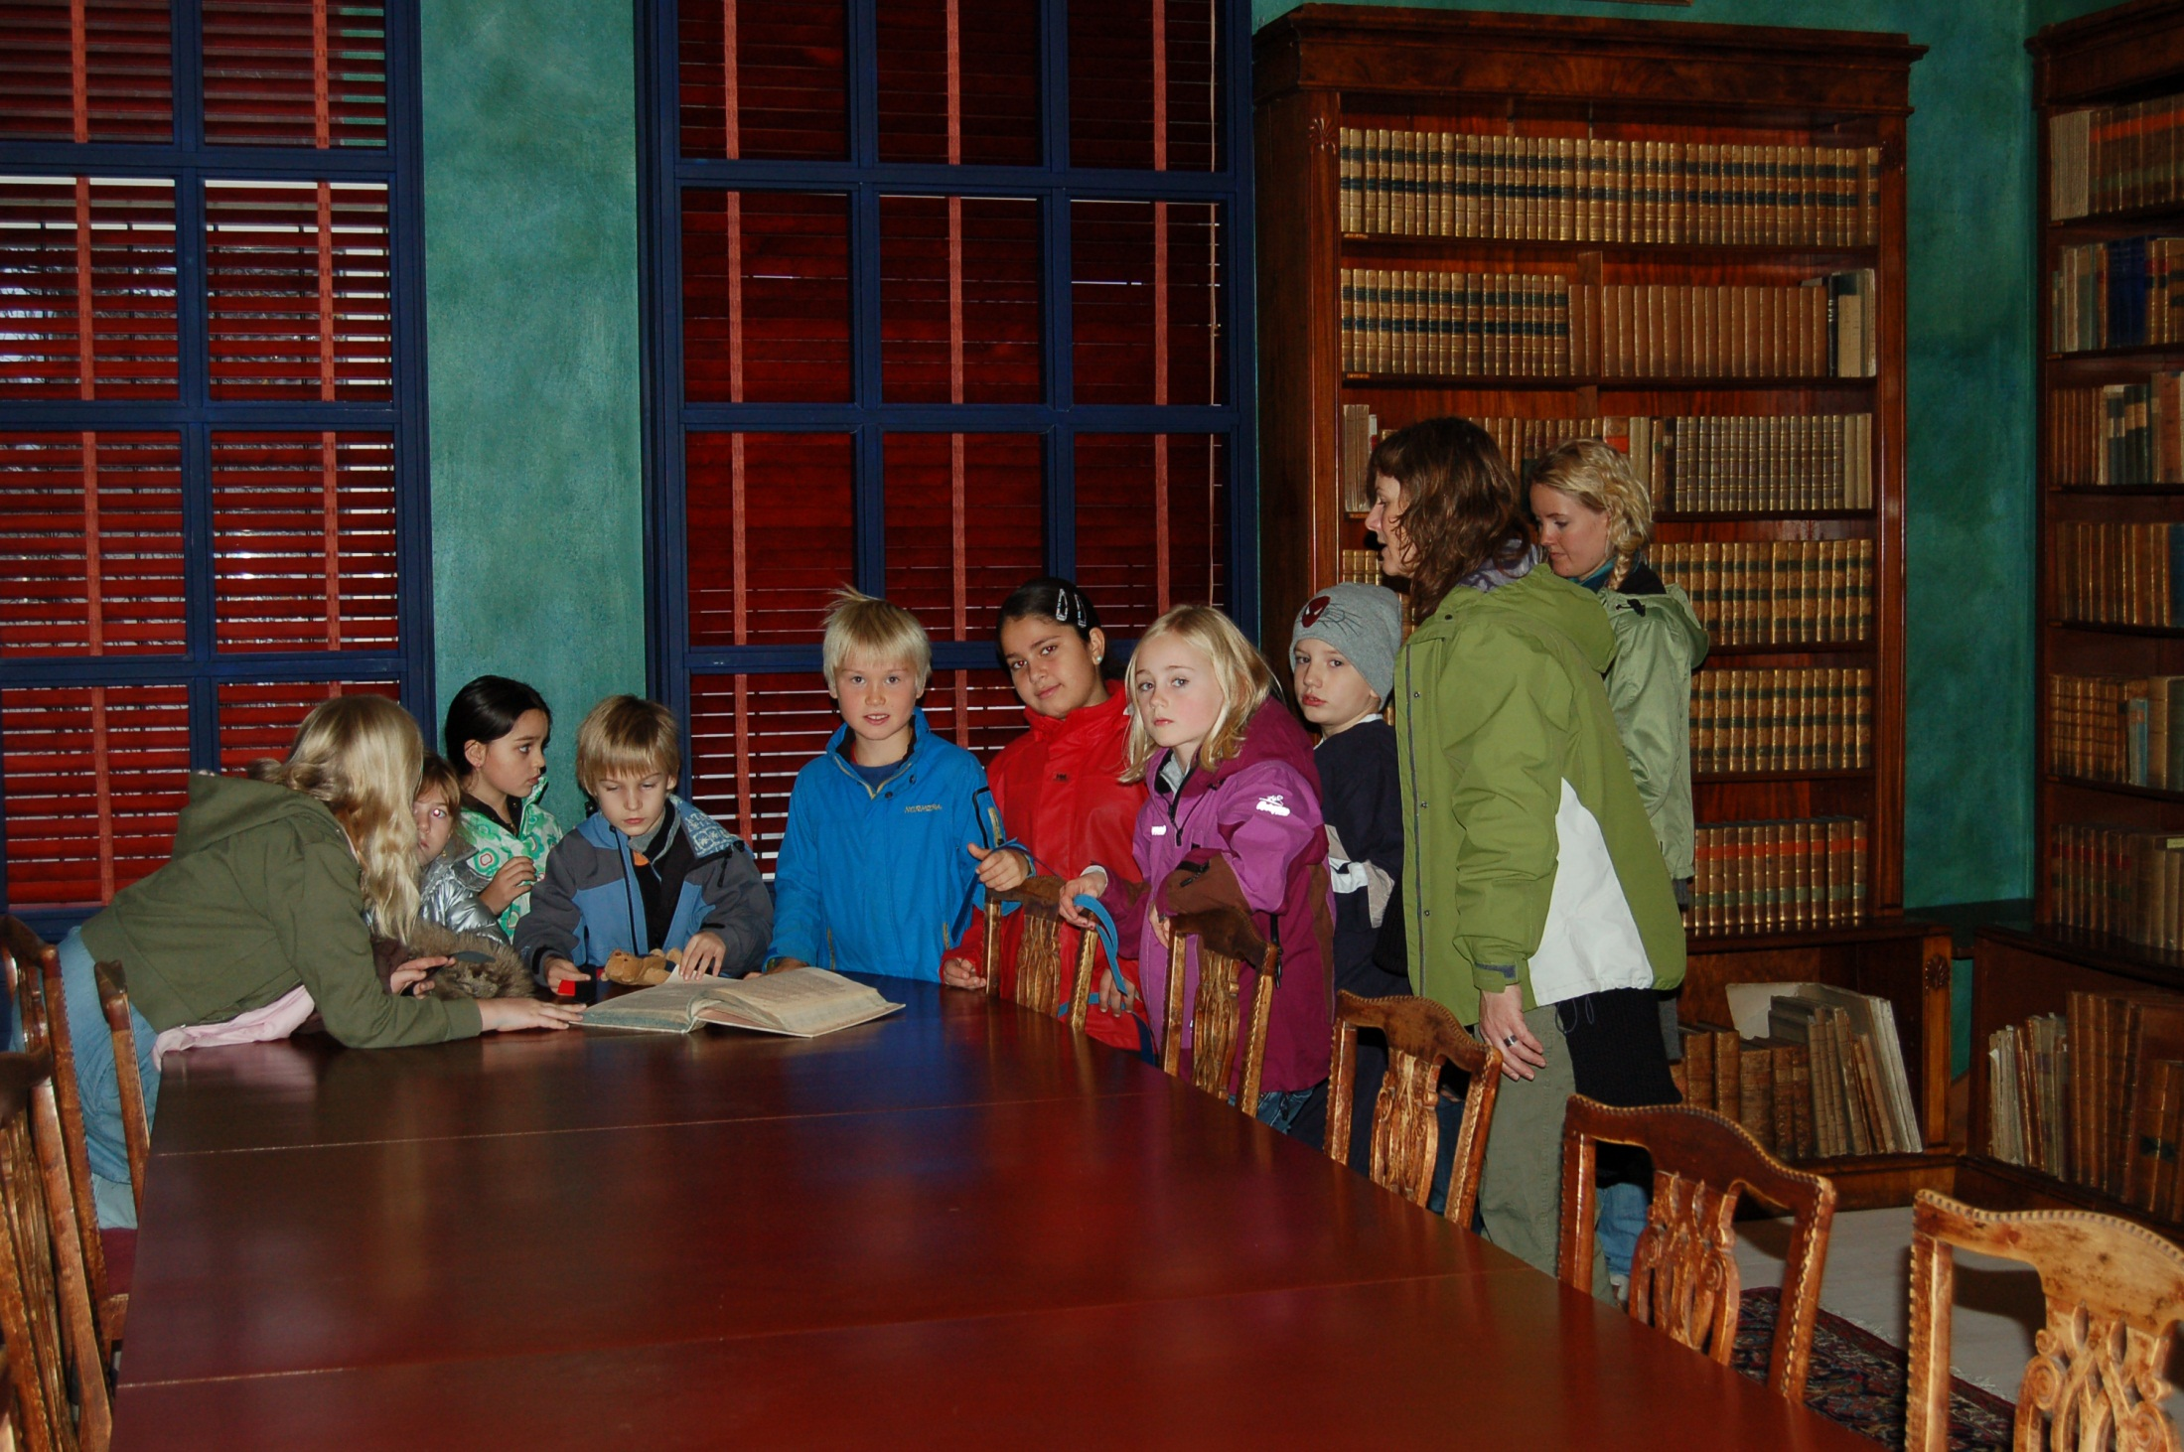
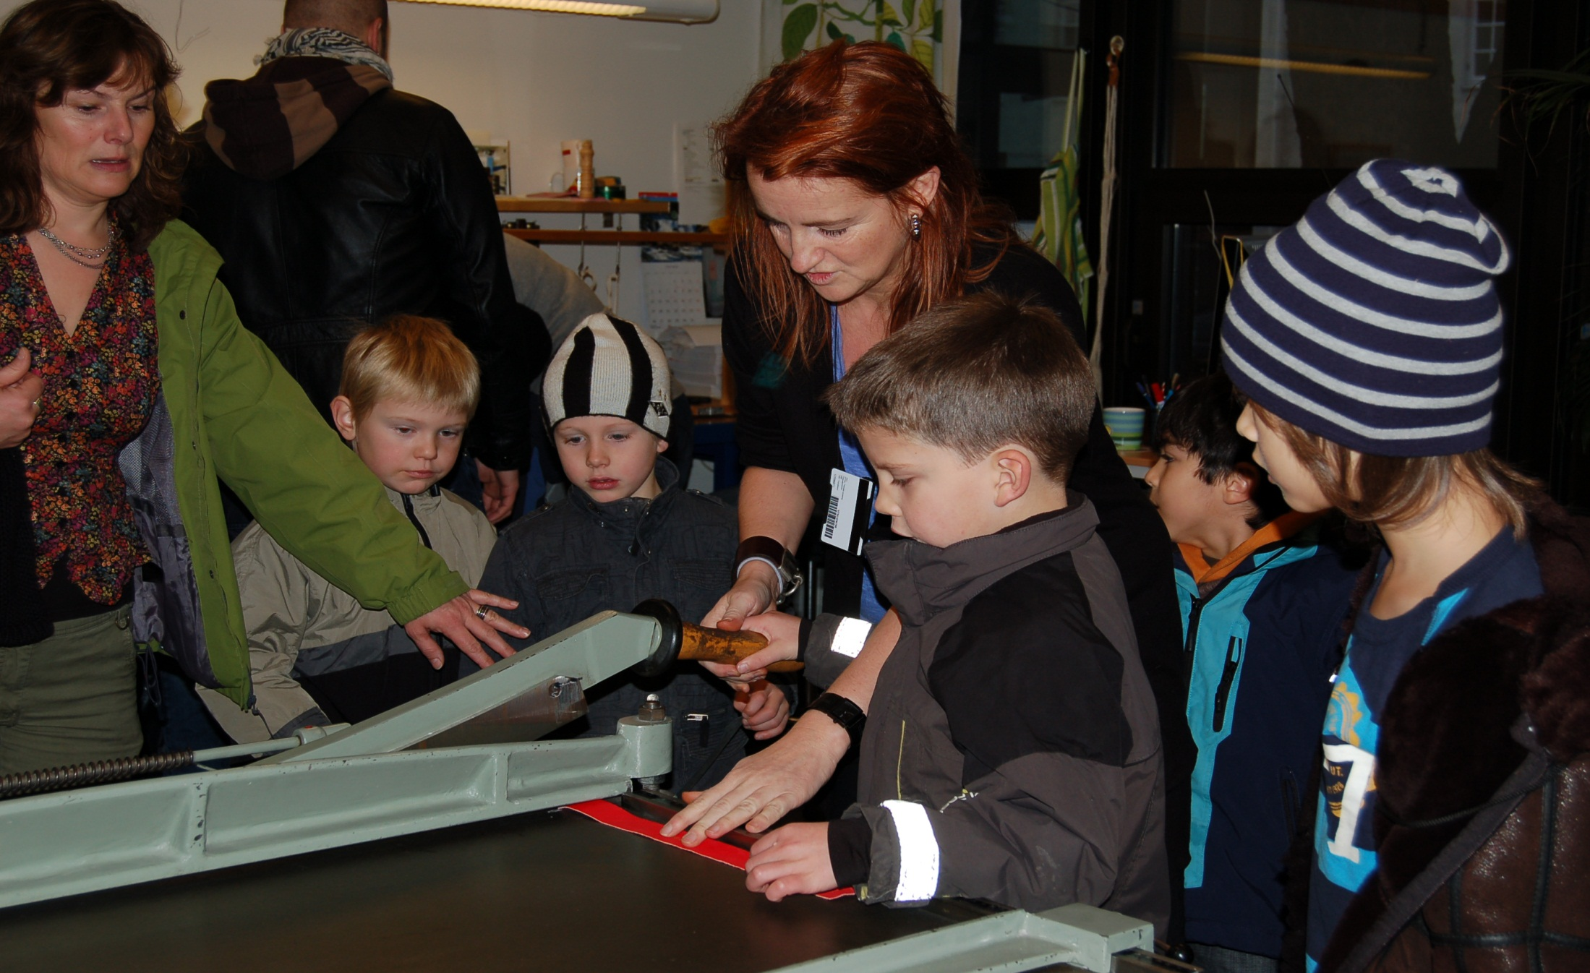
Til hvem?

Slide 21
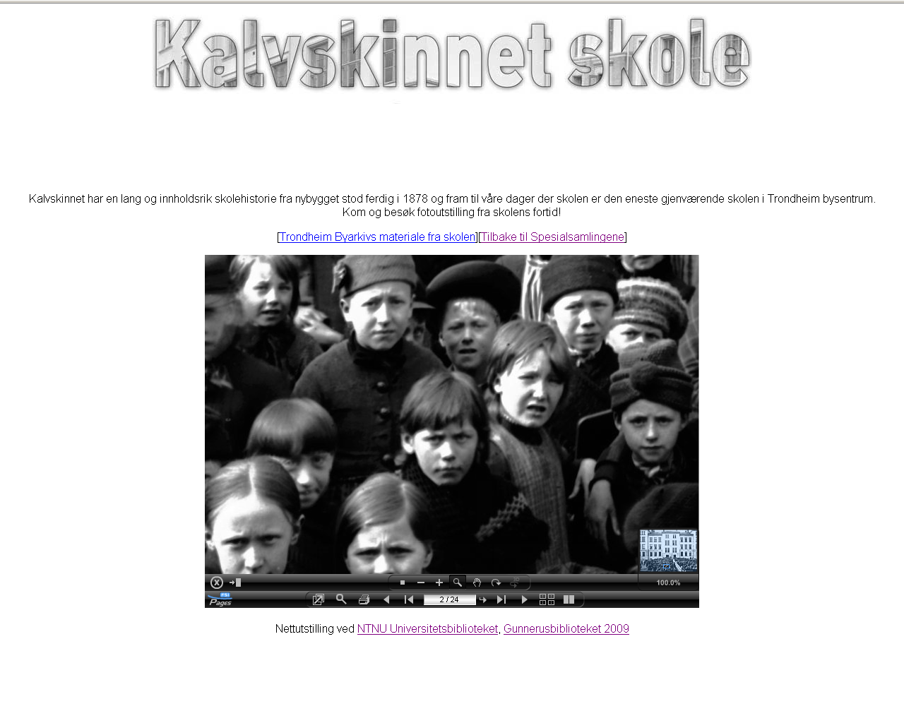

Slide 22
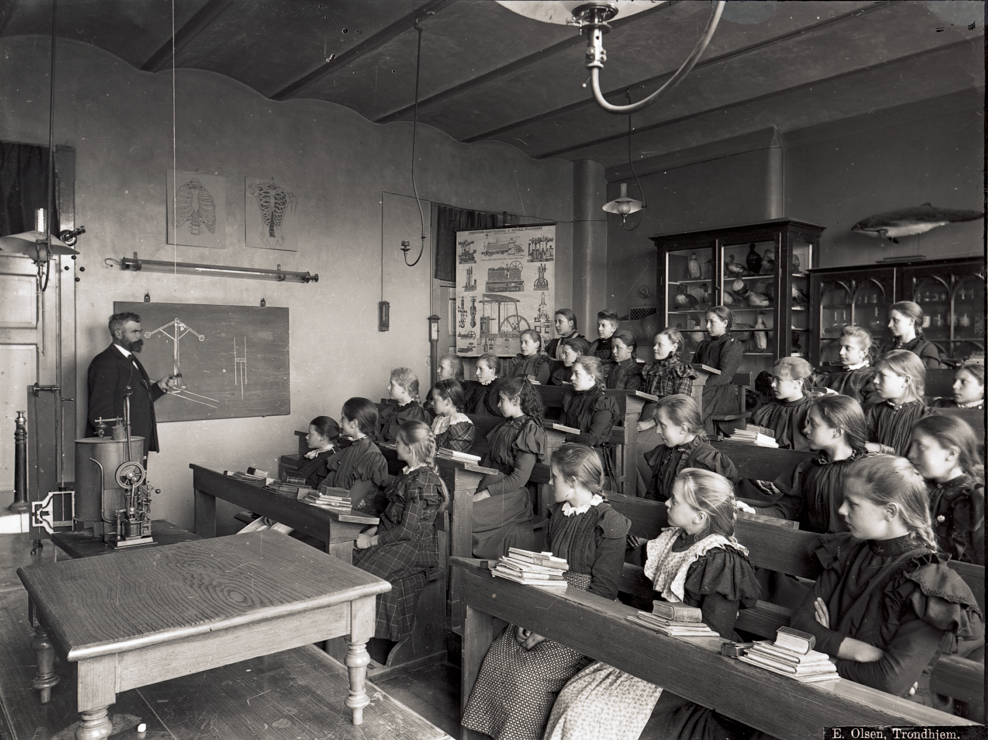

Slide 23
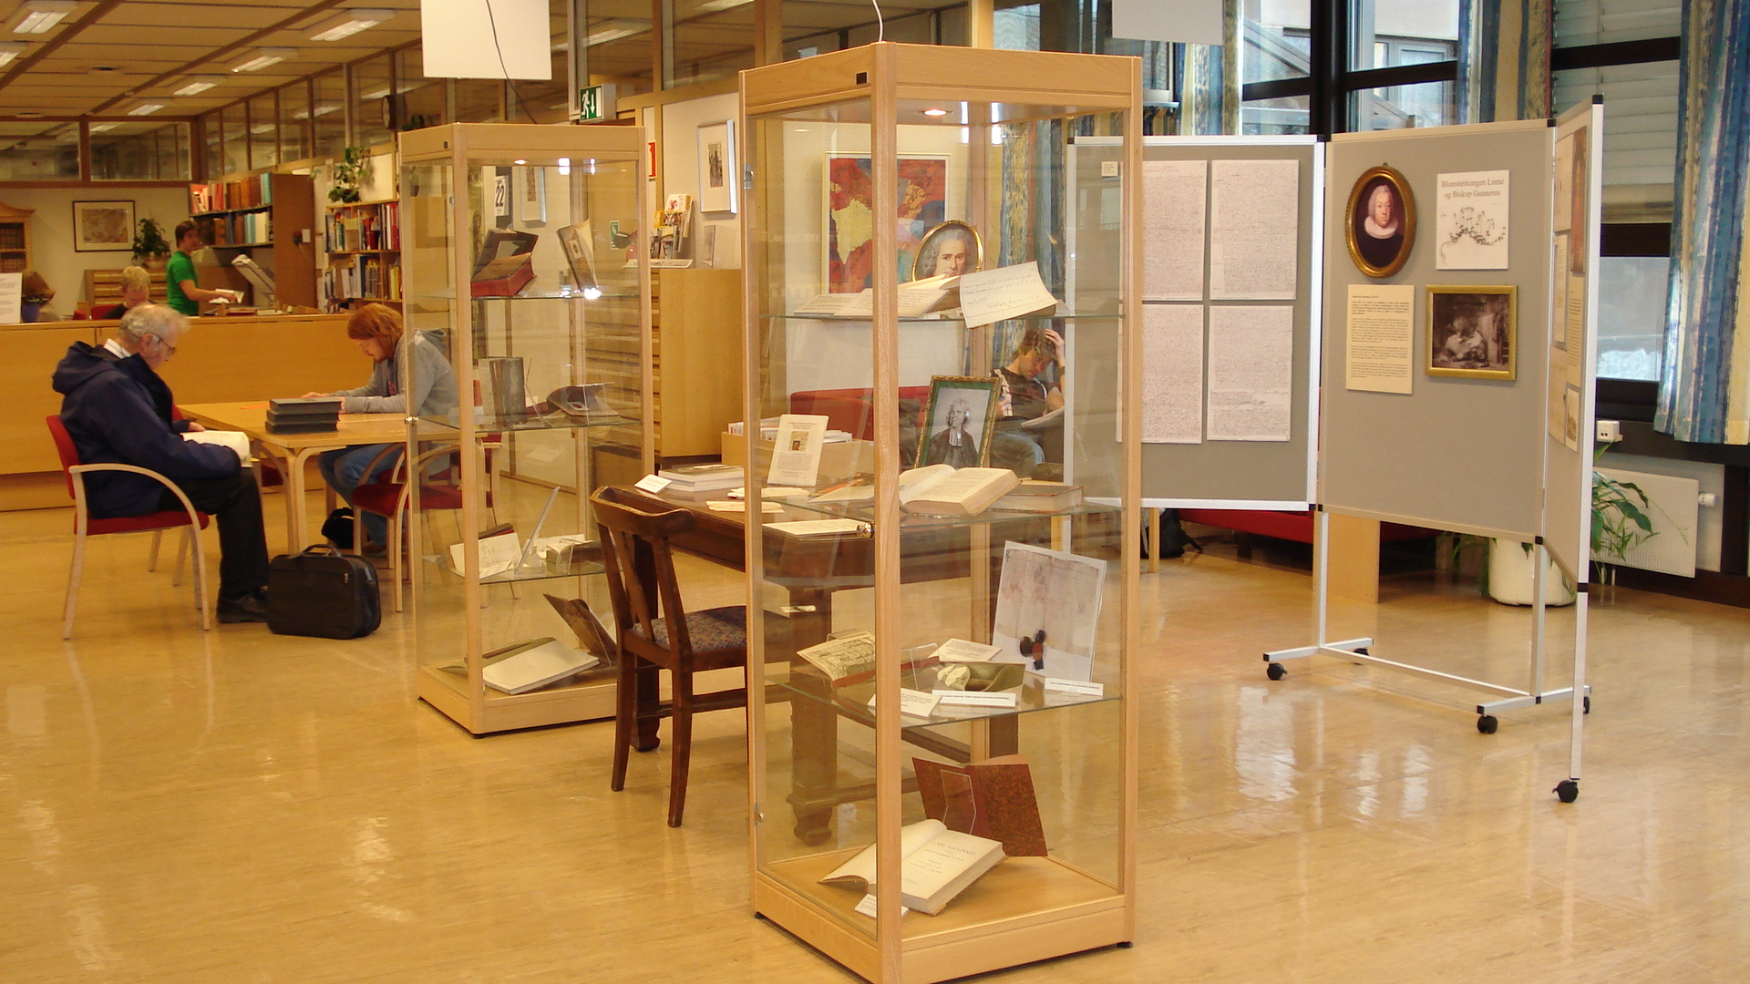

Slide 24
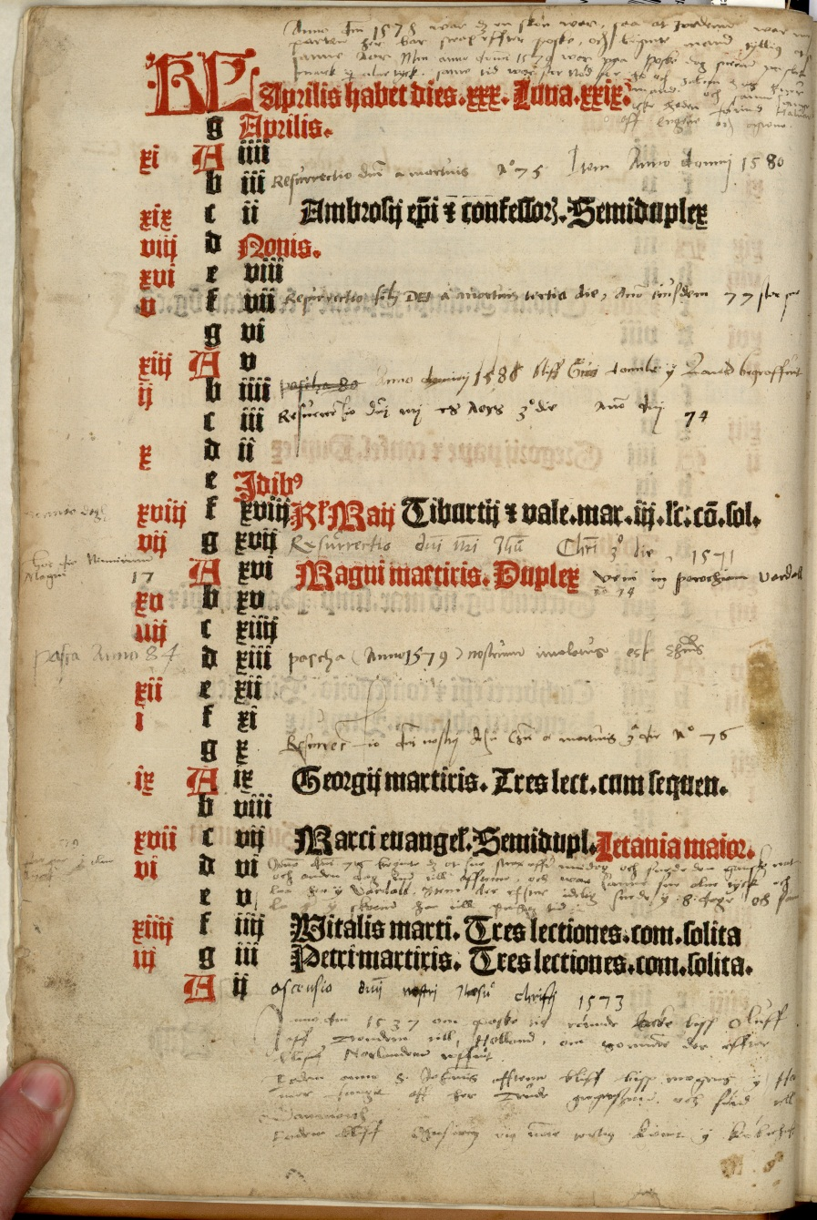
Lux illuxit
Video med musikk
Wikipedia side
«Performance»
på biblioteket

Slide 25
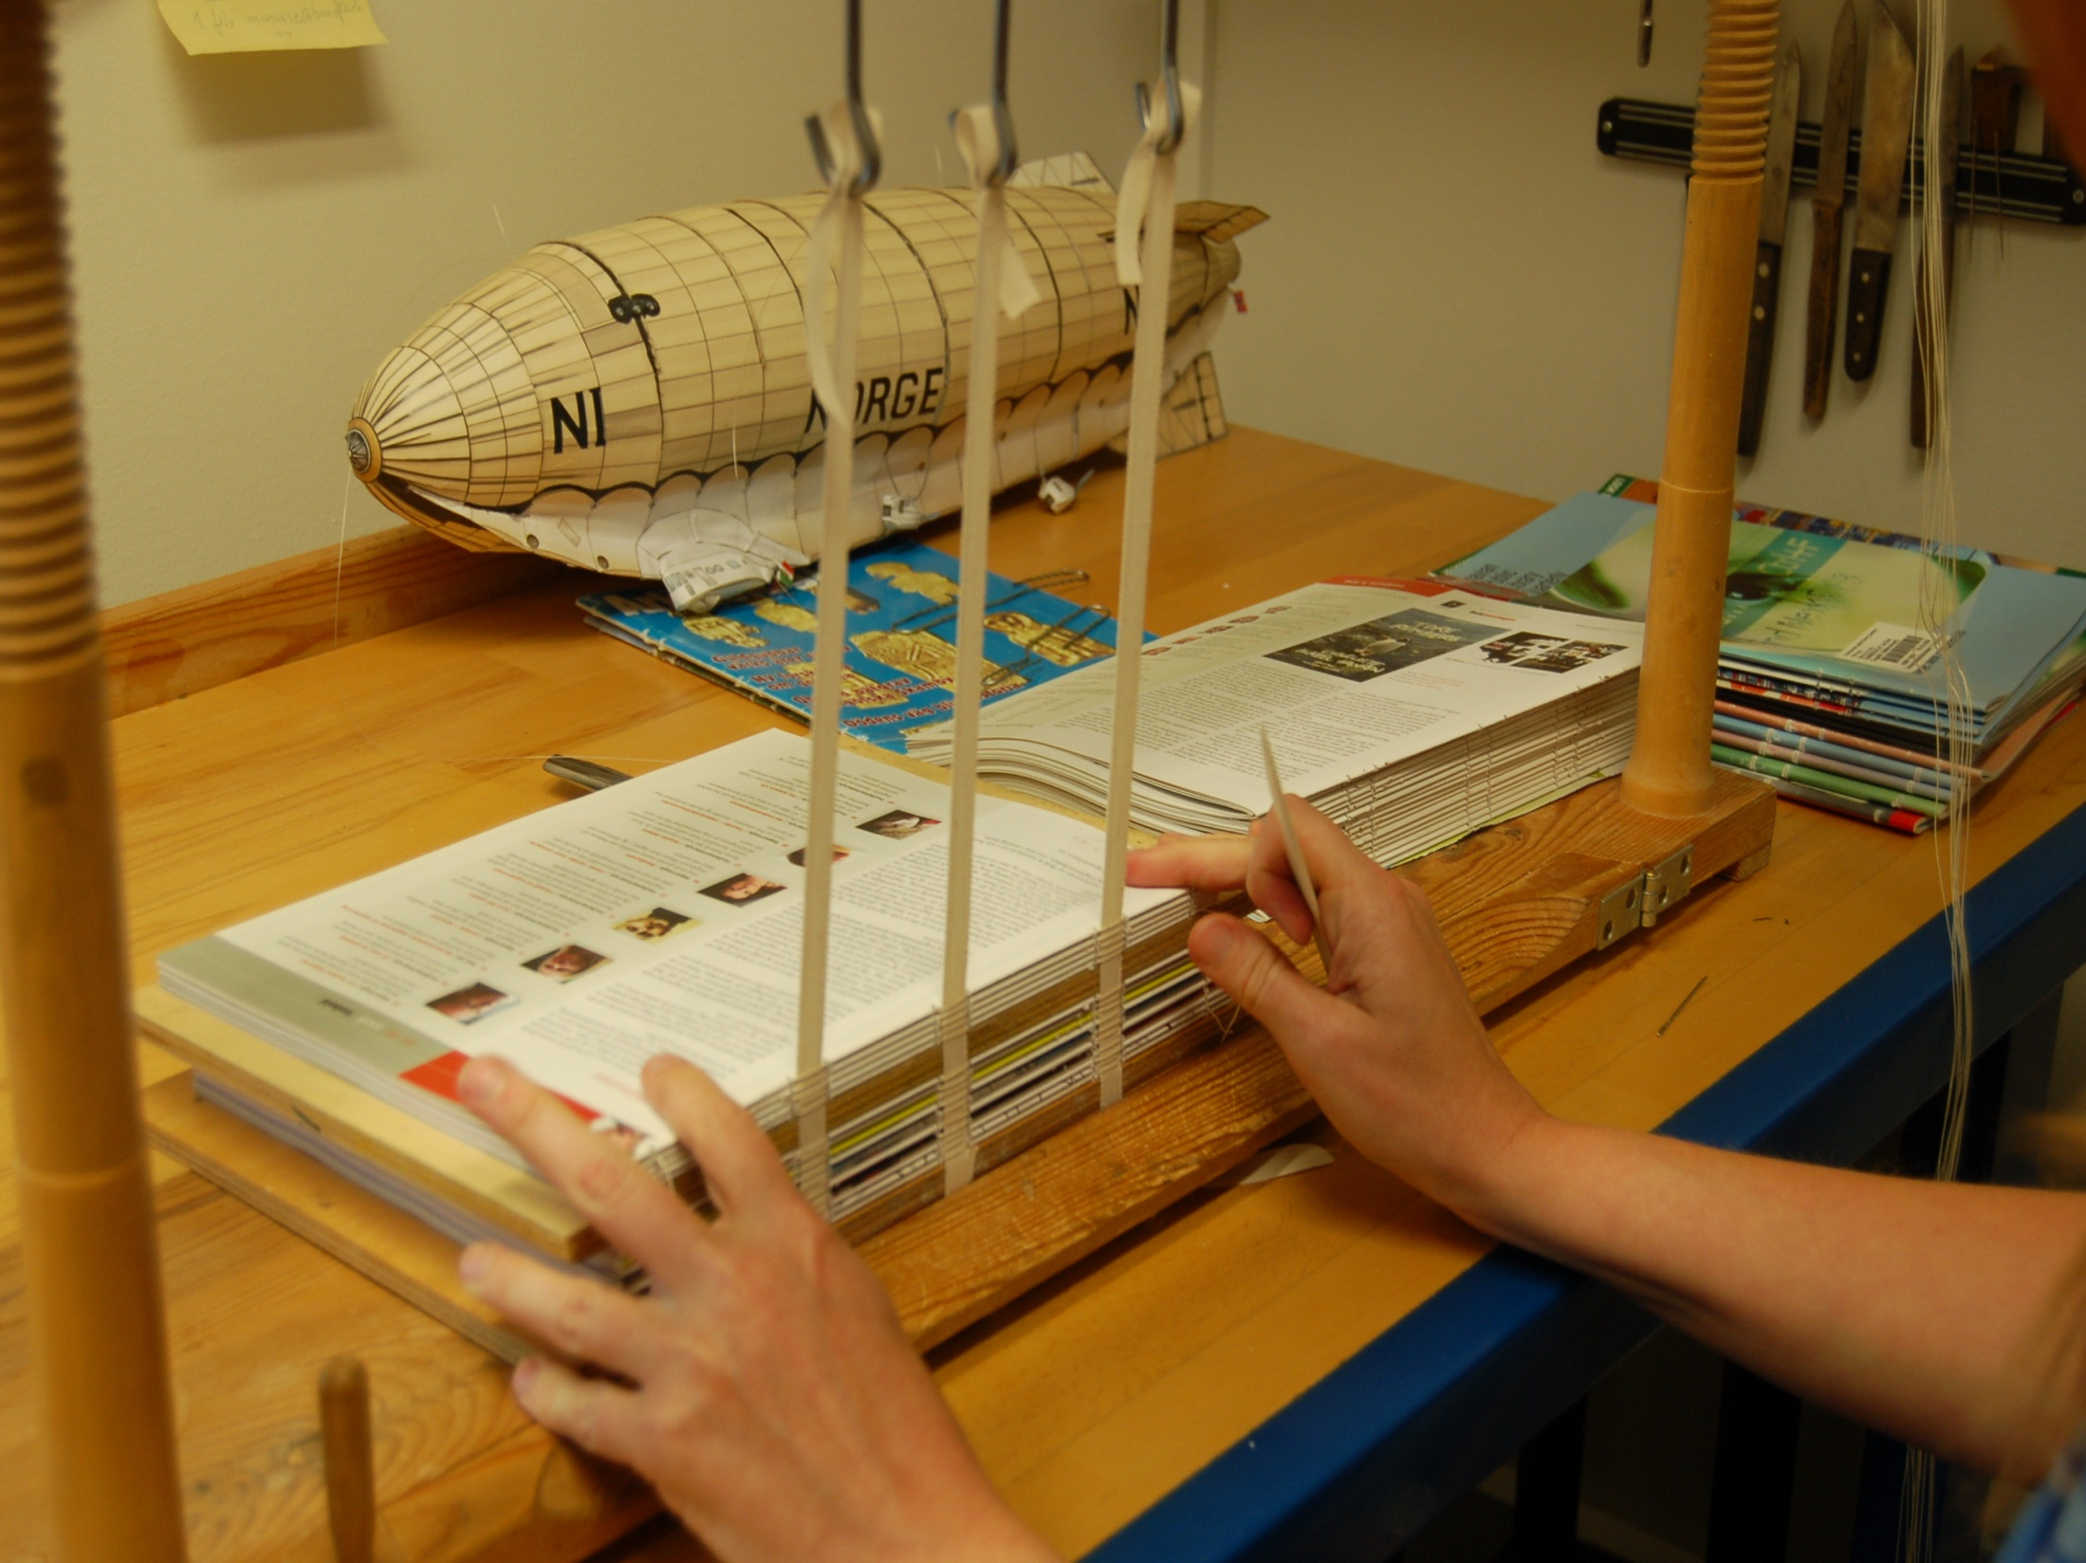

Slide 26
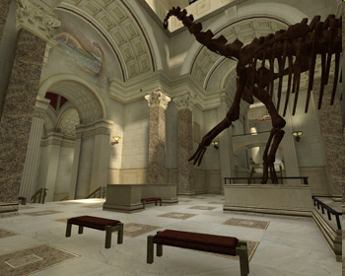
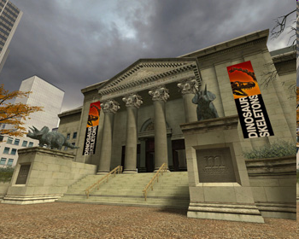
Notes:
The Museum:Source Project is an ambitious effort to model a complete natural history museum in 3D for Counter-Strike, the most popular online action game in the world. More than just a fun game level, the project is part of a novel approach to science education: infiltrating the $10 billion-a-year video game industry with truly educational content. The idea is to go beyond a simple "museum-like" virtual world and create a real museum complete with informative, lifelike exhibits. While gamers will play for fun, they'll be exposed to educational content in the process.
The process is simple in concept, and complex in application. Utilizing an arsenal of 3D and graphics tools, the level designer crafts a virtual building with all of the visual details created by real world architects and interior designers. From marble walls to ornate column capitals, every element of the museum building is modeled in three dimensions, textured, and placed in position. Specialized software tools allow for adding shiny metallic trim details to floor tiles and creating atmospheric beams of light complete with dust motes floating about. The process takes weeks or months depending on the complexity of the level. The Museum:Source level is expected to take 6 months start to finish.

Slide 27
Hva kan dere jobbe med?
Alt som dere kan tenke dere!
Innhold
Teknologi
Videoer
Intervjuer
Andre ideer?
Where to find us:
http://gunarchives.blogspot.com/
http://folk.ntnu.no/angeleta/mubil/index.htm
Hva som er gjort?
3D technology
Basic Transmission Hologram
XVR technology
Digital media
3D reconstructions
Og mer?

Slide 28
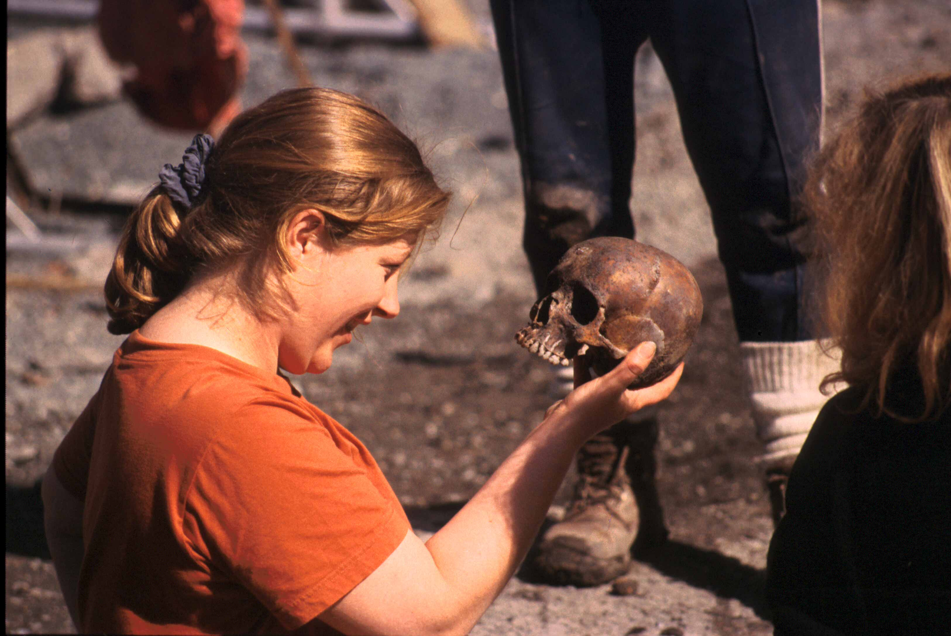
Det er en faglig utfordring og en mulighet til å lære om deg selv i samspill med andre.

Slide 29
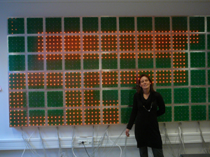
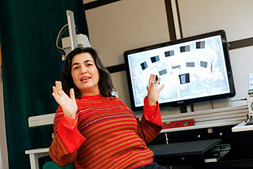
Where to find us:
http://gunarblogspot.com
http://folk.ntnu.no/angeleta/mubil/index.htm
http://artentnu.wordpress.com/

